Slide 1
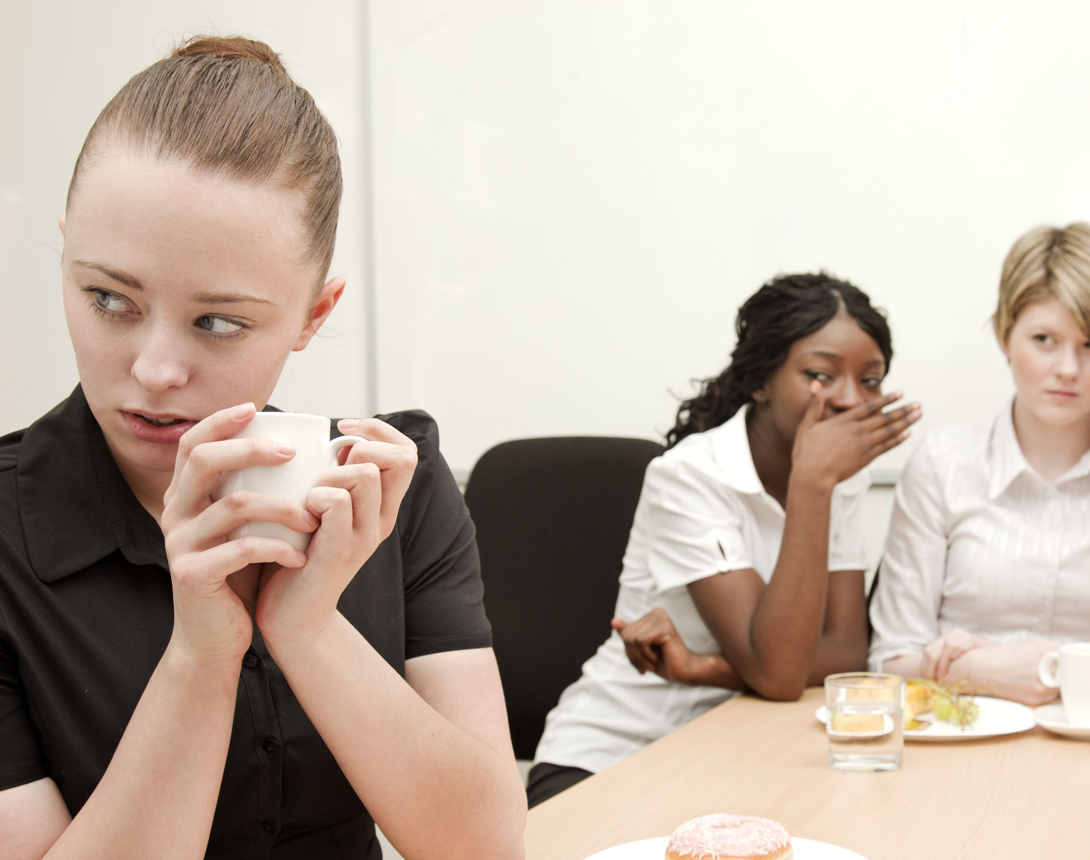
Banter, Bullying -
Behaviors, Choices and
Consequences
*Acknowledgements to:
Hamilton Nash Law
Active Bystander Campaign
Civility Saves Lives

Slide 2
‘Banter’
Playful and friendly exchange of teasing remarks..
between consenting people of equal status or position*

Slide 3
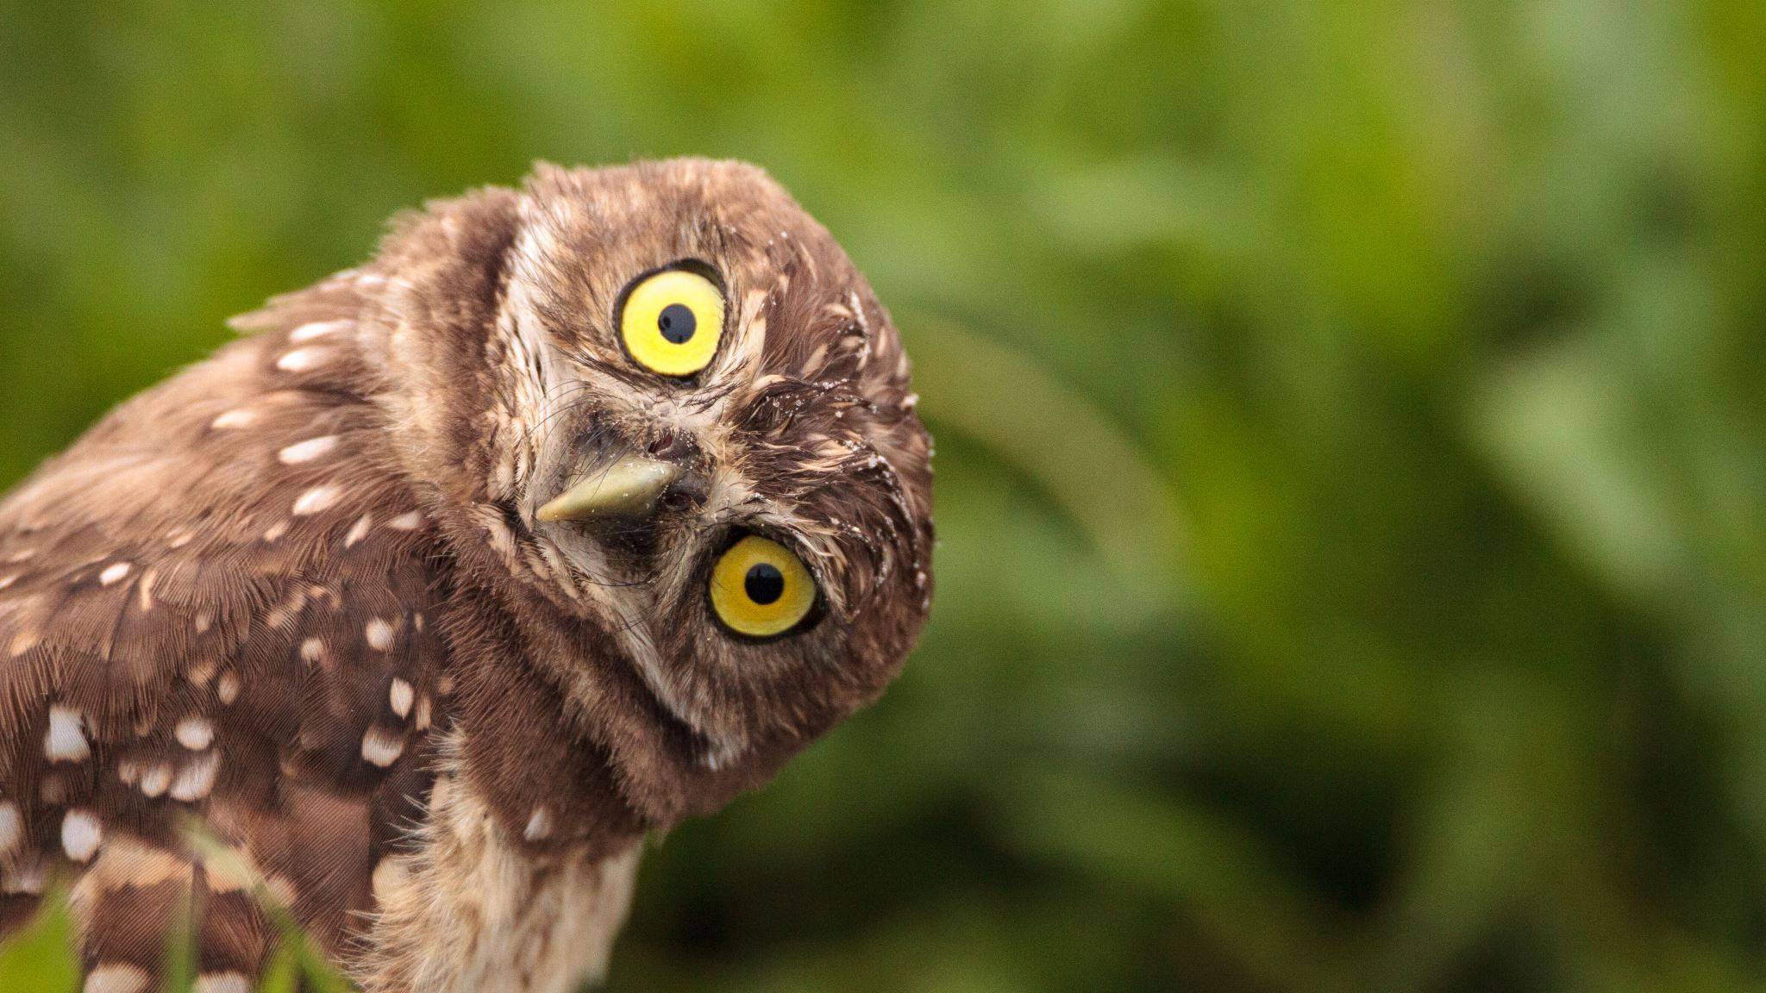
Genuine, and fun

Slide 4
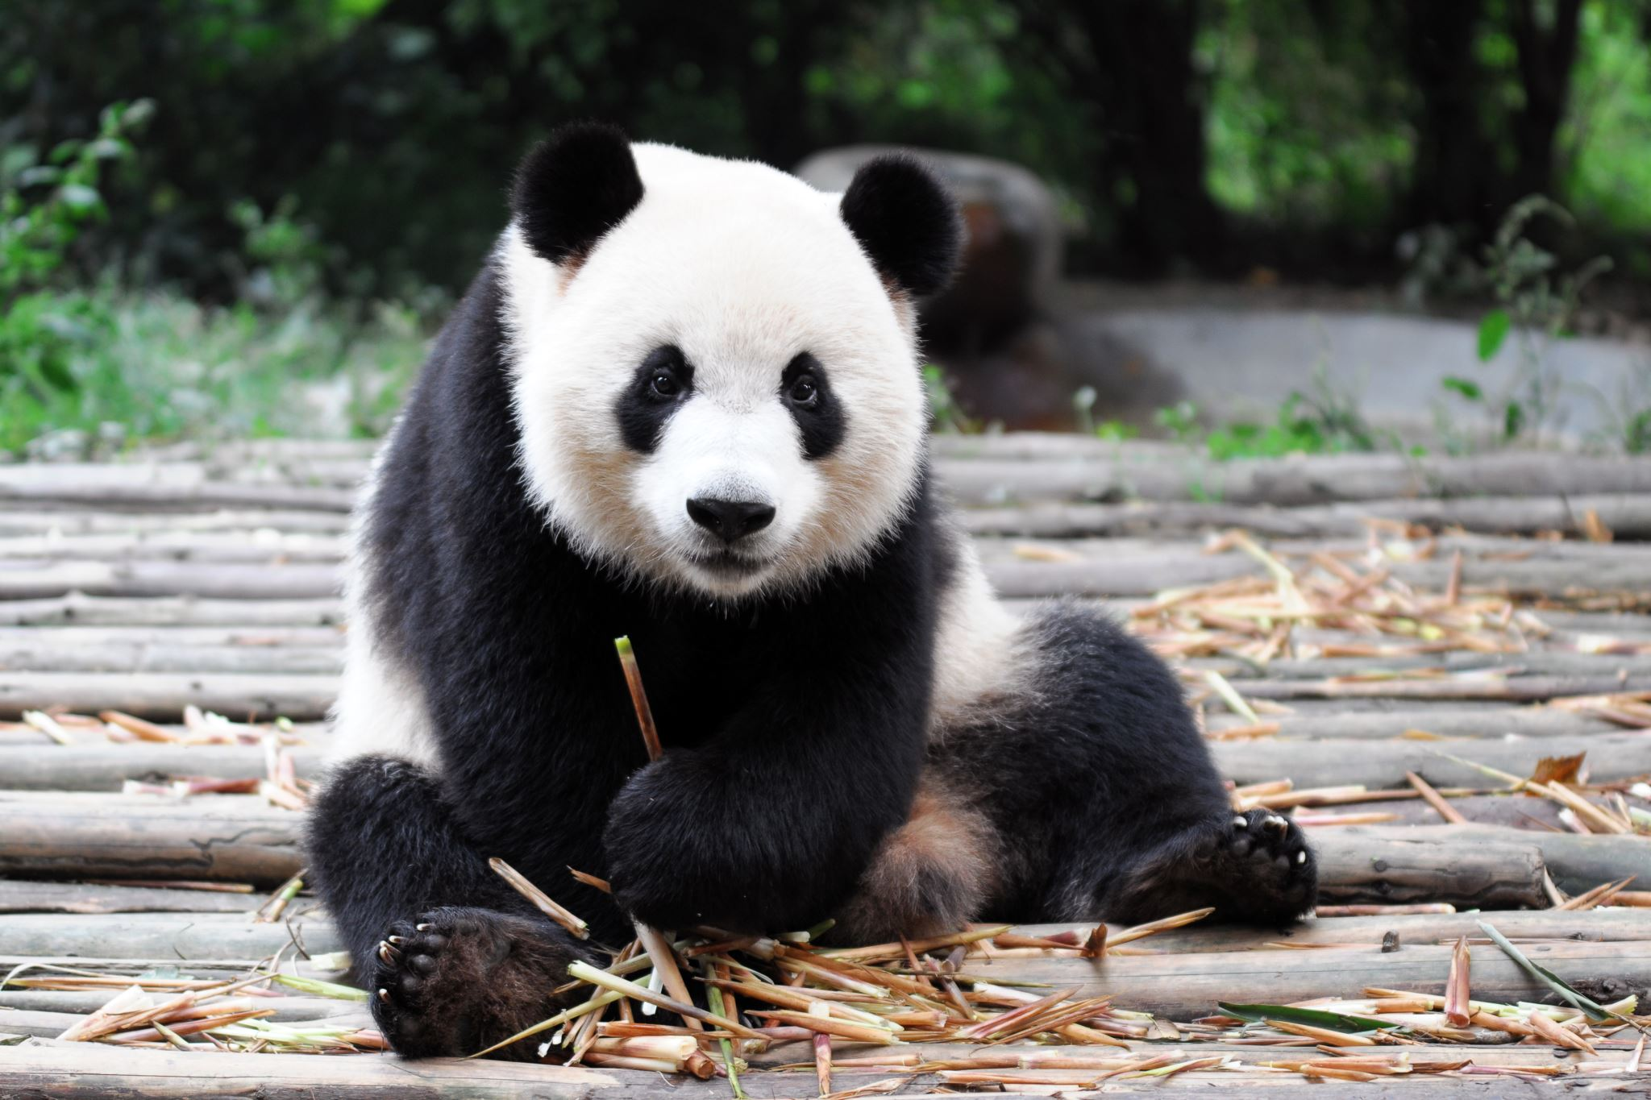
Just not realising

Slide 5

Delibrate; nasty

Slide 6
Banter at work – bottom line
‘This is just ‘PC gone mad’
No
‘Does this mean you can’t even have a laugh and a joke here anymore’?
No

Slide 7
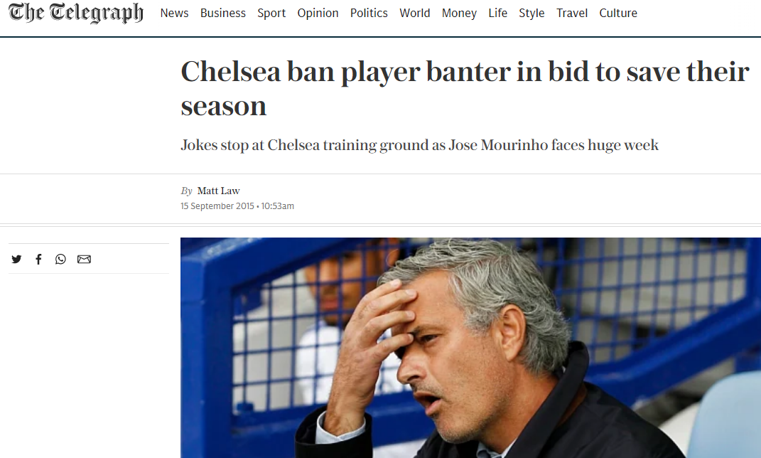

Slide 8
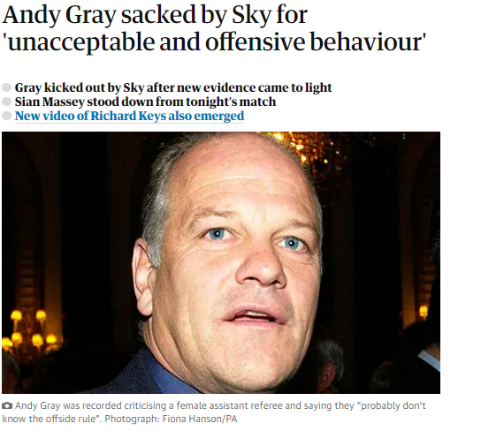
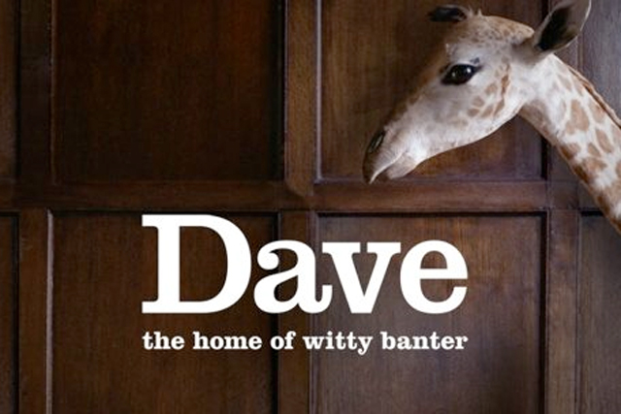


Slide 9
Playful and friendly…
Consenting….
Status….
“Playful and friendly exchange of teasing remarks..
between consenting people of equal status or position”

Slide 10
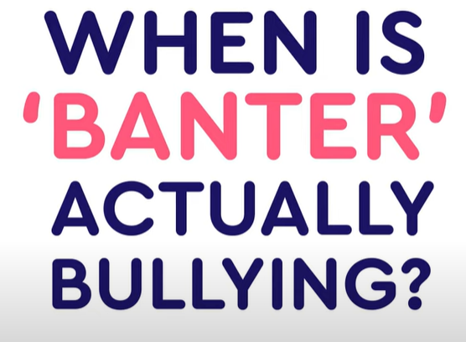


Slide 11
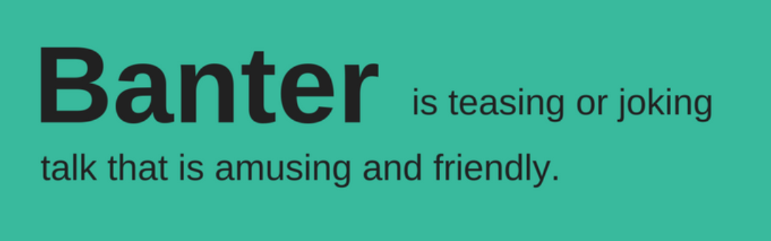

Slide 12
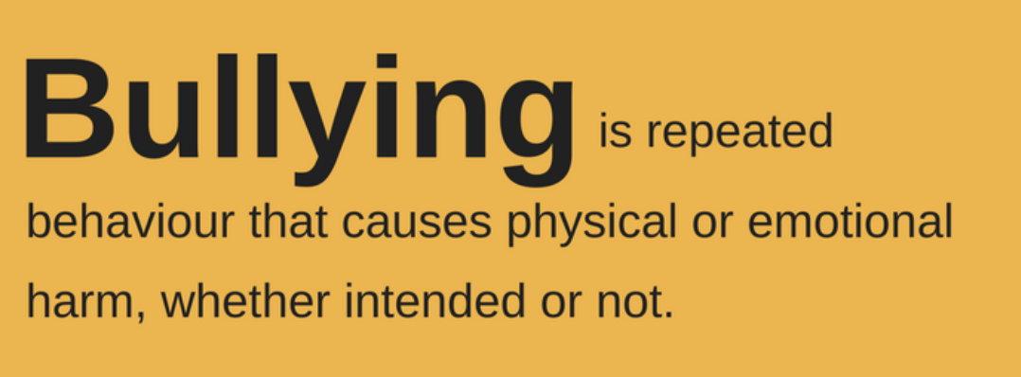

Slide 13
“Aw, c’mon – it’s just a bit o’ banter’ ?
Is only one person in on this same old joke?
it’s not banter.
Is it really embarrassing, insulting or shaming, especially when there’s an audience?
it’s not banter.
Is the comment about someone’s gender, sexuality, disability, race or other protected characteristic?
it’s not banter.
Is it a creepy sexual comment or advance?
it’s not banter.
Does the person being ‘joked’ about say, or look like they really don’t like it?
it’s not banter.

Slide 14
Think before you speak – what you think is ‘banter’ will have consequences
1 Protected characteristics – smart/veiled comments?
2 Compliments / oversharing – really? (Friendly vs. Real friends)
3 ‘Close to the bone’ comments – do you know the person, would that be funny if they said it to you, your partner, your son/daughter/best friend?
4 Other person – are they new starts, junior or in a minority (e.g. only M/F?
5 Team culture – same joke over and over, may go to breaking point in hard times?
6 ‘Funny’ or angry email/teams comment/social media?

Slide 15
Protected characteristics
Age
Disability
Gender reassignment
Marriage and civil partnership
Pregnancy and maternity.
Race
Religion or belief
Sex
Sexual orientation

Slide 16

The impact of banter is assessed from the claimant's point of view, in the eyes of the law it is only their view that matters.

Slide 17
What happens when we see bad behaviours?
The majority of witnesses to inappropriate behaviour do nothing ……..
Why?

Slide 18
What stops us from saying something?
“Time” – 3%
“My business?” – 11%
“Not sure who to talk to” – 23%
“Not serious enough” – 25%
“Scared of outcome”- 39%

Slide 19
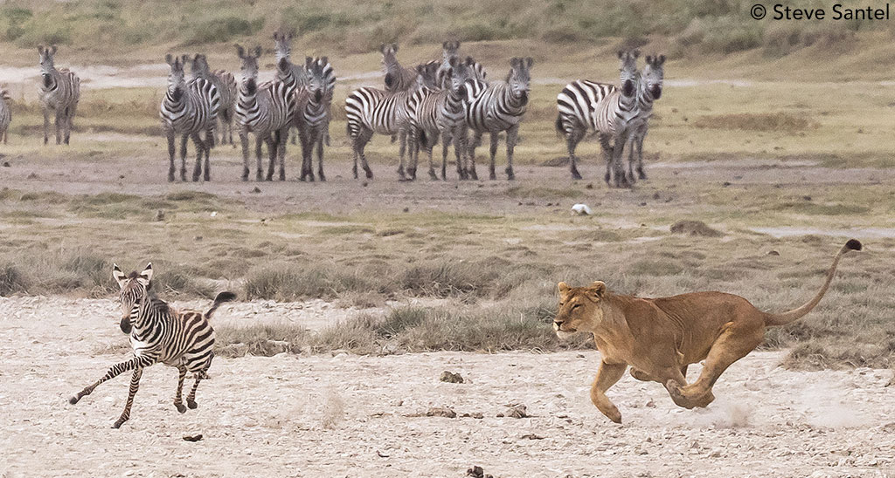

Slide 20

So, if you chose to do something…..?
Sometimes just speaking up was enough
Often, people are not aware of the impact their words or actions have on others

Slide 21
Nasty ‘banter’ facts
When someone at work says something rude or nasty to you….
80% lose work time worrying about the rudeness
Work quality goes down by 38%
47% end up going off sick
25% take it out on others

Slide 22

The ‘WITS’ tool
‘When you say or do …..’ (or don’t say or do)
‘I feel ……’
‘The effect / impact on me is …..’
‘So, I’d like to talk to you about …..’

Slide 23
So, what can I say?
Talk from ‘I’ and the focus to you; this stops you sounding judgemental:
Say how it feels,
Name the behaviour,
Say how you want the person to respond
‘I don’t like jokes about race. Please don’t make them anymore’
‘I didn’t like what you said about those people. Please don’t say that anymore’
‘I don’t want you to make personal comments about my body, so please stop’
‘People just don’t say that kind of thing anymore, please stop’

