Slide 1


Performance Report
26 May 2021

Slide 2
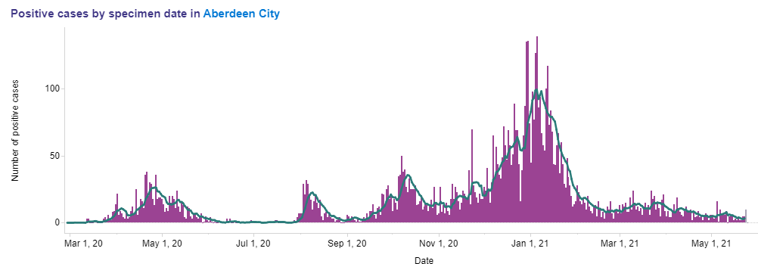
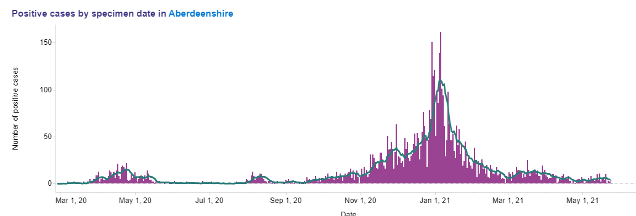
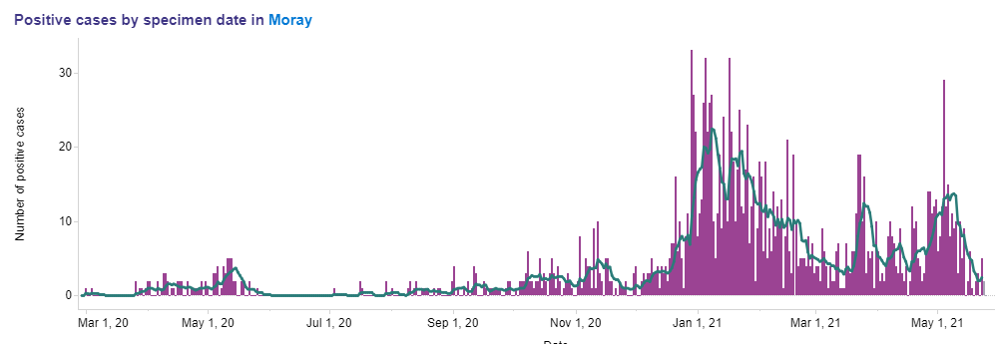
COVID - 7 day positivity
Aberdeen City
Aberdeenshire
Note the variation in COVID case rates in Grampian
Proactive use of intelligence and early support where case rates are changing
Targeted approach with partners and public in Moray – increased testing and acceleration of the vaccination programme
Important that we continue to follow guidance and protect our communities as lockdown measures ease
Moray

Slide 3
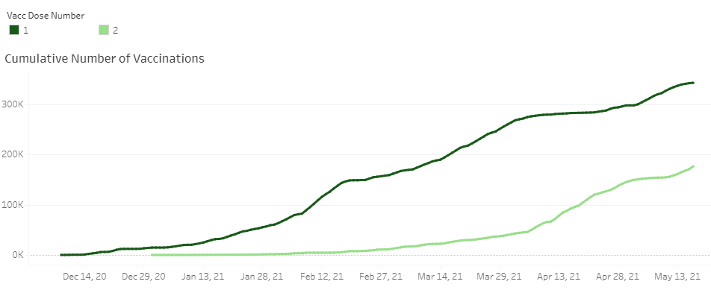
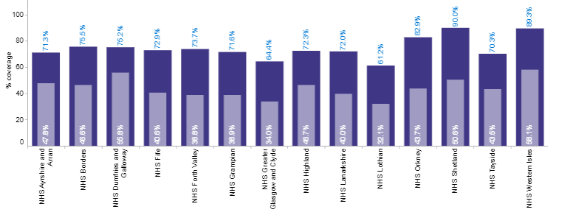
Vaccination position – 19 May
343,543 of 1st doses given - 71% of the adult population.
181,445 of 2nd doses given – 37% now fully vaccinated.
The overall uptake rate is 92.1% for women and 90.5% for men in cohorts 1 to 9.
City
61%
33%
Shire
76%
43%
Moray
86%
42%

Slide 4
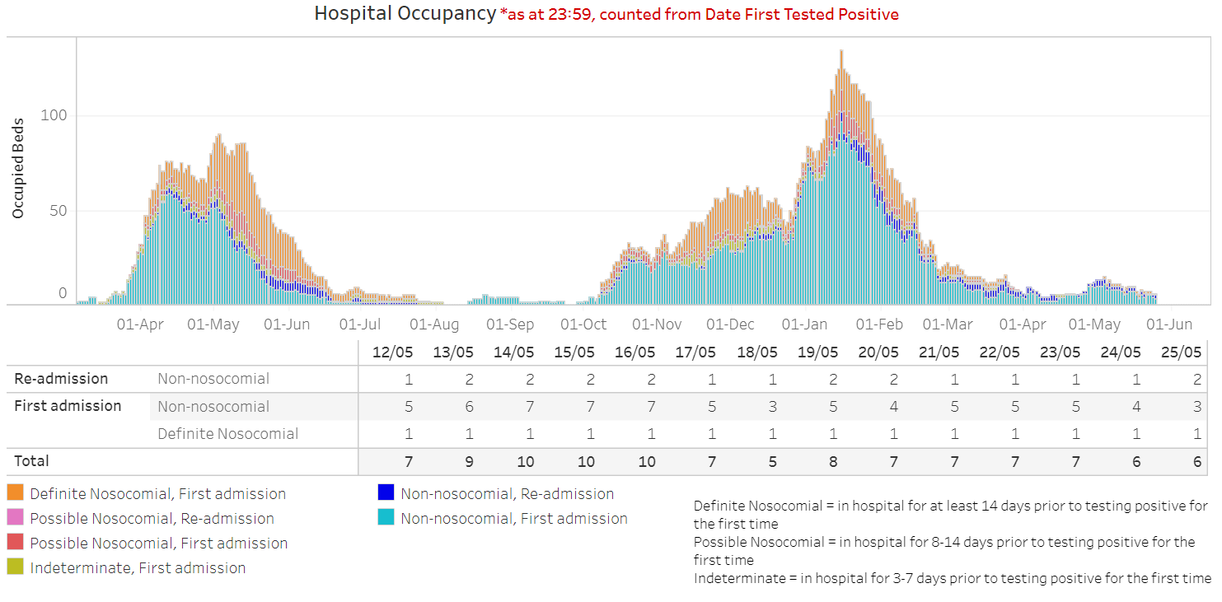
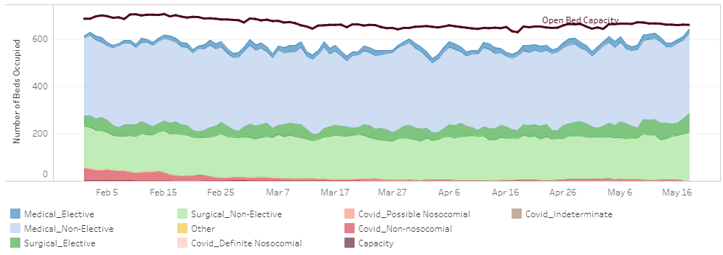
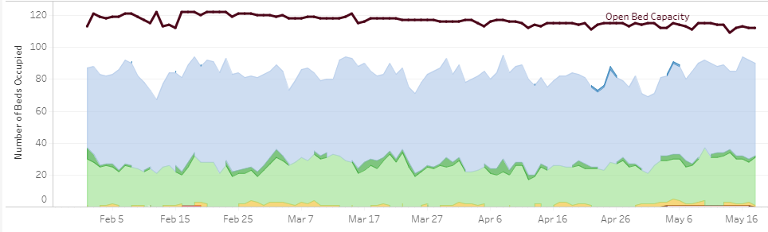
Surge and Flow
Fewer covid patients in hospital but significant pressure on bed occupancy
ARI bed occupancy snapshot : 1% COVID patients; 83% non-elective patients (typically* 68%); 13% elective (typically 11%); 4% unoccupied beds (typically 20%)
Dr Gray’s bed occupancy snapshot (excluding paediatrics and neonatal/ maternity wards) : 79% non-elective patients (typically* 67%); 1% elective (typically 10%); 0% other beds; 21% unoccupied beds (typically 24%)
Pressures at front door of ARI – plan of action being implemented to address immediate issues, including reducing the waiting times for transfer from ambulances and admission from ED and Acute Admissions area into wards.
*based on May 2019
1st wave
2nd wave
Aberdeen Lockdown
Dr Gray’s Hospital
Aberdeen Royal Infirmary

Slide 5
Planned care
Key areas of focus
Capacity building
Prioritisation
Patient engagement
Through whole system redesign protected beds were established for highest priority surgical patients. As a result and a reducing bed requirement for COVID patients activity across all elective care classifications has increased since February.
For cancer patients we have secured dedicated capacity at Albyn Hospital until the end of June, increased the urology service at Dr Gray’s Hospital and established additional clinics in the Breast service.
Discussions have been progressed with the Scottish Government Access Team and Centre for Sustainable Delivery in support of our plans for increasing capacity and optimising use of existing resources.
Grampian has an established and tested prioritisation system for planned care
This ensures that all urgent and priority patients are identified following determination of treatment and that patients are seen according to clinical need.
Capacity building has been targeted at urgent and priority patients (ESCAT 0 and 1 including cancer) and to address long waiting patients.
Patients on our treatment time guarantee waiting list (~10k) have received a explanatory letter with an apology for the delay and highlighting escalation routes for them to raise concerns relating to their health.
Patients waiting over 52 weeks (~4k) have also been contacted and invited to feedback on the quality of life impact on them to inform how we can reflect their needs into our remobilisation planning.
We are currently evaluating the feedback that has been received to inform our recovery and remobilisation plans and activities.

Slide 6
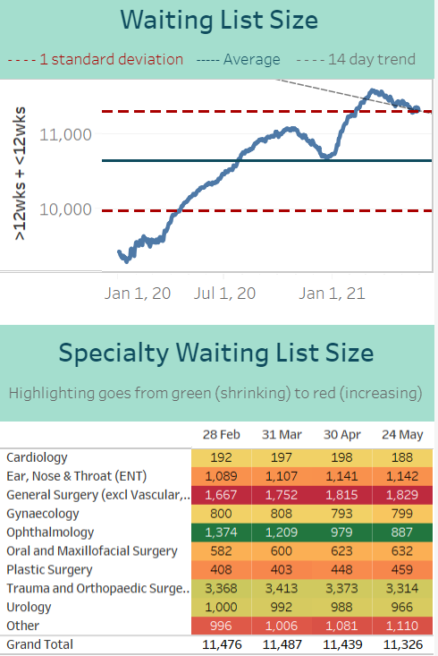
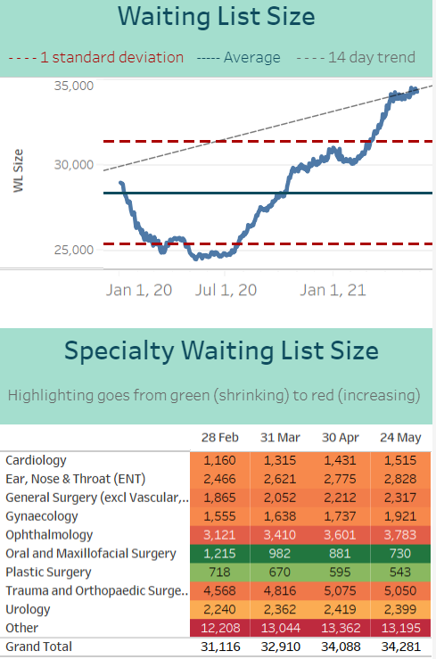
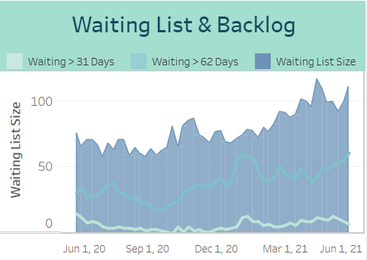
Planned Care
Treatment Time Guarantee
Outpatients
As a result of the action being taken as part of the remobilisation plan there has been
A stabilisation of the number of patients waiting for treatment and a small overall reduction
An increase in performance against 31 and 62 day cancer targets but an overall increase in waiting list size as referrals return to pre-COVID level and
A slight increase in the overall waiting list size for a new outpatient appointment; with further steps being taken to identify ways to increase capacity. Near Me appointments continue to represent about 30% of overall outpatient appointments.

Slide 7
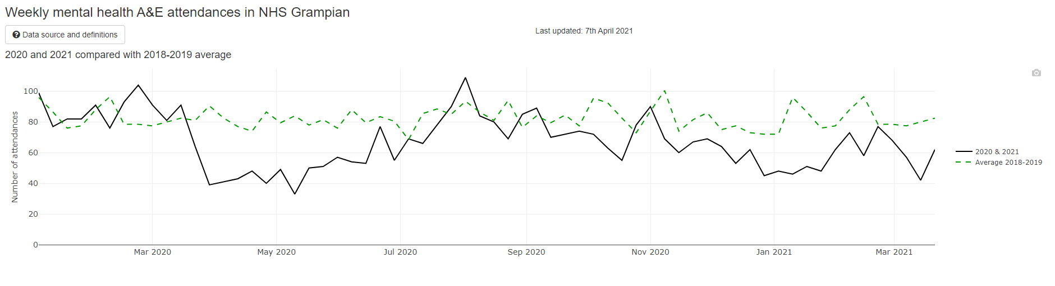
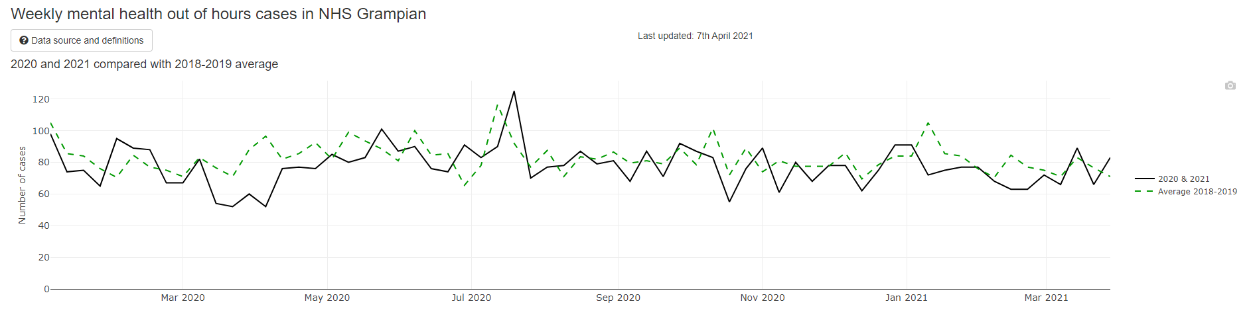
Mental Health: A&E attendances and out of hours cases
60% fall in A&E attendances during 1st lockdown; 52% at early part of 2nd lockdown. Currently 25% lower than normal (Scotland average 10% lower)
Between 30-46% lower during lockdown periods, now returning to average levels
Grampian’s return to ‘expected levels’ of A&E attendances remains lower than Scotland.
More variable pattern of out of hours cases throughout the pandemic across Scotland compared to Grampian

Slide 8
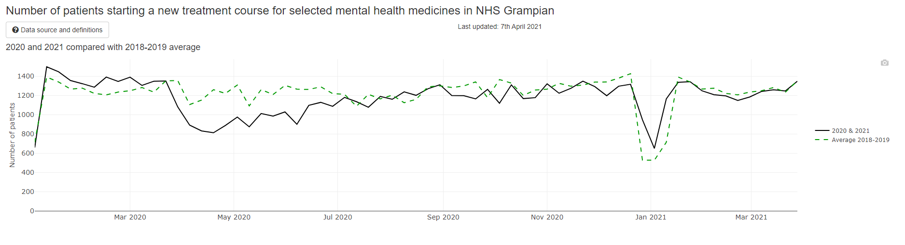
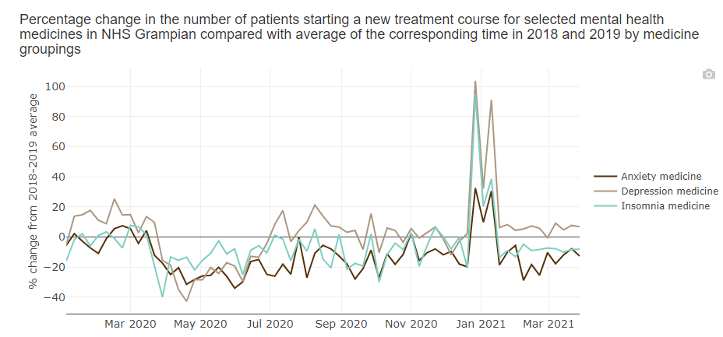
Mental Health: prescribing and new treatment courses
No. of patients starting new treatments now at similar levels to average, following significant drops at each period of lockdown
Following a c40% fall in new treatments for anxiety, depression and insomnia during the first lockdown, treatments for depression have been above average since July. Treatments for anxiety and insomnia all remain below average (except for January 21).
Grampian prescribing patterns are similar at national level.

Slide 9


We Care, Because You Care

Slide 10
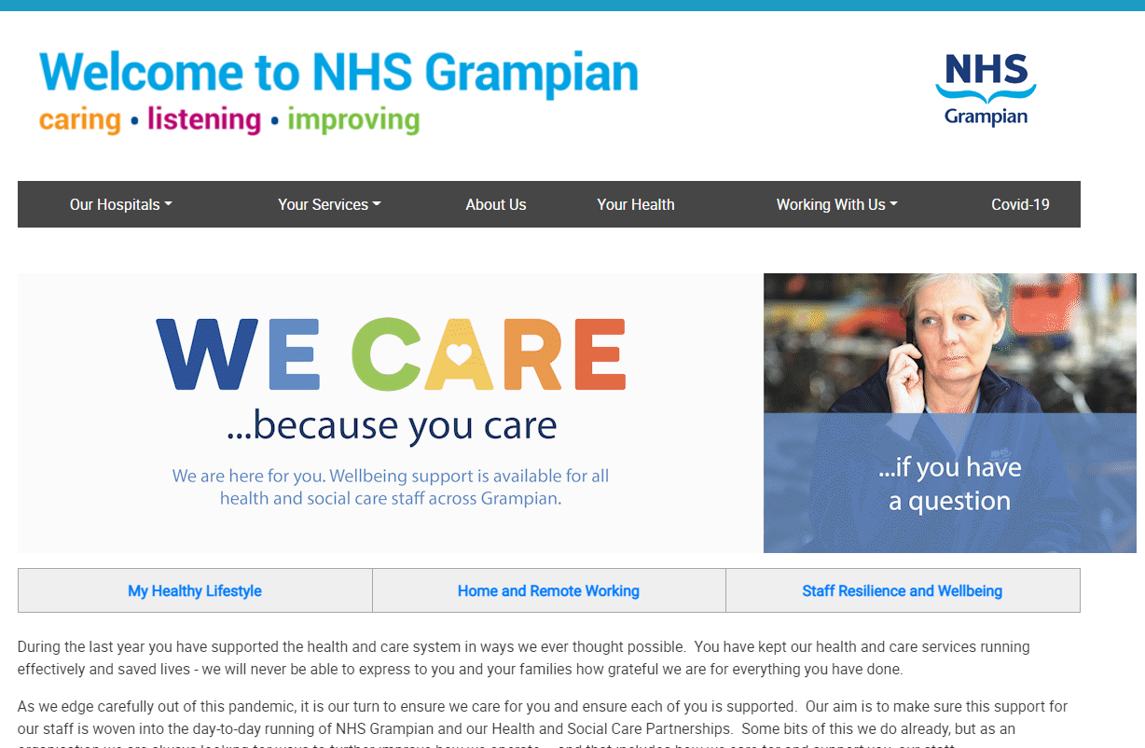
Reactive to Proactive: We Care
Launch on 5th April to coincide with transition from Operation Snowdrop
Branded mugs, pens, treat and letter for all staff to raise awareness, and encourage taking a break to connect
Funded by SG Monies and Endowments (NHS Charities Together) and supported by Catering and Red Cross Volunteers
Quarterly Pulse Survey to follow – ‘how are you?’…and how are we doing?

