Slide 1
Operation Iris Progress against key objectives
OBJECTIVES
A. Keep staff safe & help them to maximise wellbeing
B. Responding to demand on the health & care system
C. Protecting critical services & reducing harm
D. Reshaping our relationship with communities
E. Creating a sustainable future
Data as at 25 May 2022

Slide 3
Executive Summary
Introduction
The purpose of the report is to enable the Board to review progress against the three objectives which focus on delivery of services for Operation Iris.
Context
At the April Board meeting it was reported the impact of increased community transmission of Covid on staff absence and hospital admissions had been very significant and had further disrupted service delivery. This situation has improved. Scotland-wide data shows an eighth consecutive weekly fall in the number of people testing positive for Covid.
In Grampian, Covid admissions and occupancy have decreased and ICU Covid occupancy remains low and stable. Ward closures due to Covid also remain very low, with 2 on 24 May.
However, despite improvement in the Covid position, the demand across the system continues to challenge the ability to consistently meet the three Operation Iris objectives:-
Keep staff safe & help them to maximise wellbeing
Responding to demand on the health & care system
Protecting critical services & reducing harm
It is known the pressures are impacting on the experiences of people in receipt of care or awaiting care, and the experience of colleagues giving care.
A. Keep staff safe & help them to maximise wellbeing
The impact on colleagues across Grampian has been significant with the COVID response now having been in place for over 2 years. The We Care programme continues to provide a wide range of support however this is likely to have more of an impact in the medium to long term than immediately.
The results of the Best Practice Australia (BPA) Culture Survey (first phase) have been shared with the teams who took part in this first phase and actions in response being developed.
B. Responding to demand on the health & care system
Hospital occupancy remains at very high levels across NHS Grampian, with some areas at or near 100%. Grampian Care home occupancy remains high but relatively stable.
Similar pressures are being experienced in primary care and in the community There has been a decrease in the number of hours of social care that have been unable to be provided in all areas, however, all eras remain above average.
The Grampian Operational Escalation and Pressures System (G-OPES), used to assess the system pressures and inform our whole system daily response meetings, has been predominantly at level 3 to 24 May 22. Level 2 was reported on three occasions earlier this week, the first level 2 reports since February. Royal Cornhill Hospital has been at level 4 for over half the week
C. Protecting critical services & reducing harm
Since the last Board meeting, the continued pressure in Emergency Department and on flow through the system has continued. There are significant variations in performance from day to day and we continue to work with partners to improve co-ordination.
Despite challenges around capacity, we continue to maintain access for emergency surgery and planned elective surgery for priority patients, although it is insufficient to keep up with demand.
The Outpatient list size has fallen slightly, to just below 40,000; the Inpatient list size has increased for the eighth consecutive week. The proportion of patients waiting over 12 weeks has decreased again for Outpatients (to 46.4%) and increased for Inpatients (to 69.3%). ESCatS 1 activity continues to fluctuate around a plateau level, although still at a higher overall level of activity than in 2019.
The 31 and 62 day cancer standards were not met in Quarter 1 2022 (performance 92% and 74% respectively)
In terms of access to Child and Adolescent Mental Health service(CAMHS) we consistently remain above the national target. CAMHS performance continues to meet the 90% target, achieving 93% compliance in March. Performance of all Psychological Therapies has improved to 82.5% for March, but has yet to meet the 90% target

Slide 4
Objective A
Keep staff safe & help them to maximise wellbeing

Slide 5
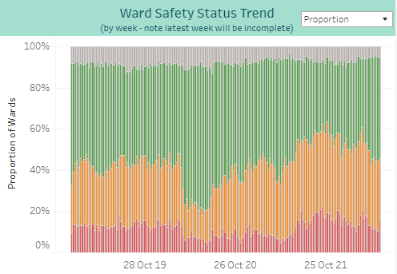
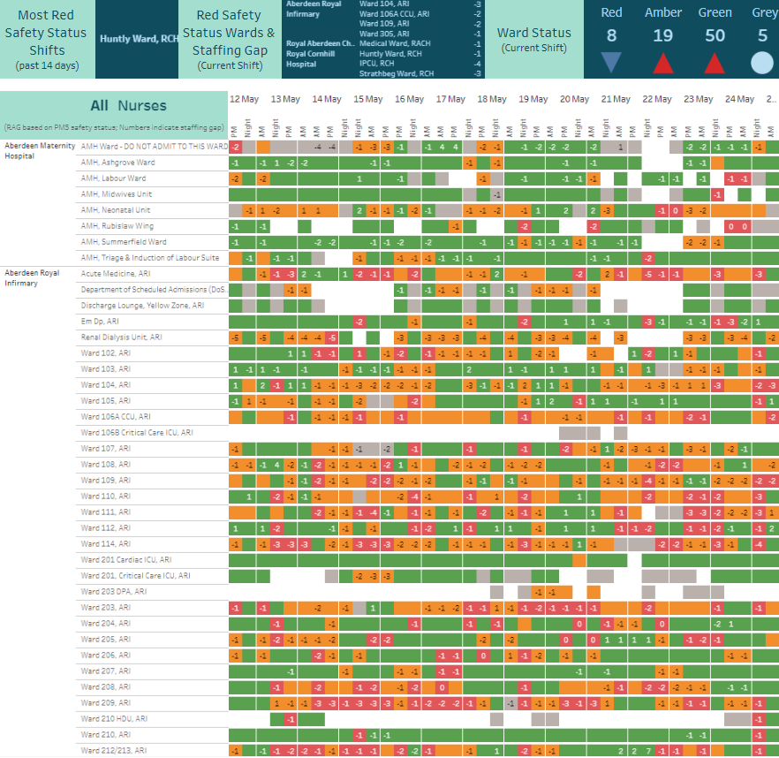
Ward Nurse Staffing (Registered & Unregistered)
The snapshot data shows a slightly worse position compared to the same time last week for red safety status shifts but an improved position for amber safety status shifts.
Some wards continue to be short up to 5 nursing staff (eg Huntly Ward, RCH)
Mondays continue to experience the highest levels of red RAG status wards in 2022. The level of red RAG status wards on Saturdays remains slightly below Monday levels
The overall trend data shows for the week beginning 16 May, 45% of wards reported a red or amber RAG status (the same level as the week before)
* Data sourced from PMS – snapshot taken 08:30 25/05/2022
From the Nursing Workforce Dashboard – Ward Staffing: Nursing Workforce Summary - Tableau Server

Slide 6
COVID-19 ABSENCES - 18/05/2022 – 24/05/2022 (DATA REPORTED IS REFLECTIVE OF DATA RECORDED IN SYSTEMS BY 17th MAY, DATA IS REFRESHED FOR PREVIOUS 8 WEEKS AT TIME OF REPORTING TO CAPTURE ANY TIME LAGS IN RECORDING ABSENCE DATA)
Covid-19 Positive |  | Current value 0.538%, which is down from previous week’s value of 0.664%.
Household Self-Isolating |  | Current value zero, which is down from previous week’s value of 0.0055%
Long Covid |  | Current value 0.0762%, which is down from previous week’s value of 0.0929%.
Quarantine |  | Current value 0.002%, which is down from previous week’s value of 0.006%.
Self-Displaying Self-Isolating |  | Current value 0.005%, which is down from previous week’s value of 0.015%.
Test & Protect Isolation |  | Current value is zero, which is the same value as the last week.
Underlying Health Condition |  | Current value 0.026%, which is down from previous week’s value of 0.038%.
Vaccination Reaction |  | Current value is 0.001%, which is up from previous week’s value of zero.

Slide 7
ALL ABSENCES – 18/05/2022 – 24/05/2022
Annual Leave |  | Current value 5.88%, down from previous week’s value of 6.67%.
Sickness Leave |  | Current value 3.17%, down from previous week’s value of 3.92%. Note: Includes both short and long-term sick leave.
Maternity Leave |  | Current value 1.78%, down from previous week’s value of 1.98%.
Special Leave inc. Covid-19 |  | Current value 1.11%, down from previous week’s value of 1.43%. 56.7% of special leave attributed to Covid-19.
All Other Leave |  | Current value 0.57%, down from previous week’s value of 0.67%.

Slide 8
Objective B
Responding to demand on the health & care system

Slide 9
Bed pressures within ARI: Occupancy remains at very high levels
The overall trend data continues to show very high occupancy levels
Trend at 24 May 16:44
From Illuminate report – occupancy

Slide 10
Dr Gray’s, RACH and Cornhill Occupancy
Dr Gray’s
occupancy levels remain high
RACH
there has been a general increasing occupancy trend since the start of 2022
occupancy has increased to its highest levels over the last two weeks
Cornhill
occupancy levels remain very high
Trend at 24 May 16:44
Illuminate Occupancy reports

Slide 11
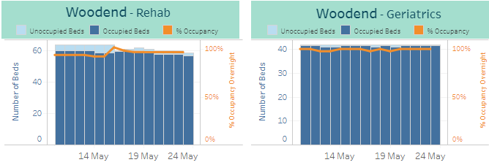
Community Hospital Occupancy
Rosewell House (NHSG only)
occupancy levels remain very high, at or near 100%
Woodend
occupancy levels remain at or near 100%
Aberdeenshire
occupancy levels remain very high
Moray
occupancy levels remain very high, at or near 100%
Illuminate Occupancy and overview reports
Trend at 24 May 16:44

Slide 12
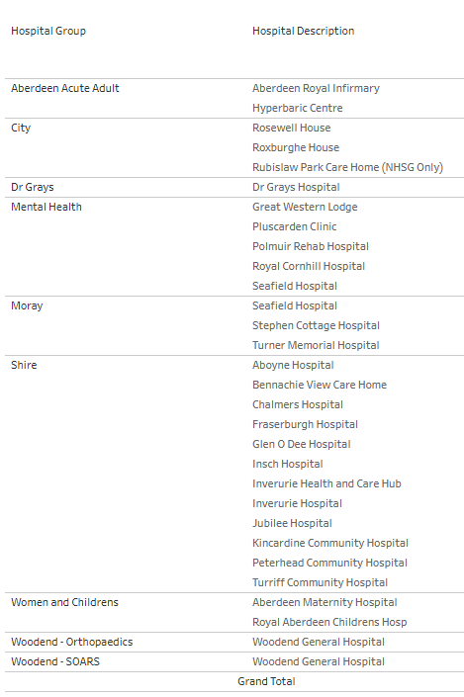
Hospital Beds
24 May 2022
The total number of beds in ward reflects the ward floor plans on PMS.
The Closed beds include closures for all reasons including cleaning, infection, maintenance staffing and Covid social distancing
The maximum beds available to use is the difference between total beds in the ward and closed never available beds
A total of 247 beds are on TrakCare with a closure reason of “Never available for use”
The number of closed beds has increased by 19 since the previous week, primarily at Royal Cornhill Hospital
The maximum number of beds available to use across all Grampian hospitals is 1836, an increase of 1 from last week
Dr Gray’s and Moray bed numbers are currently under review
Click here to go to the Illuminate dashboard - Bed Allocations to Specialties and Bed Numbers in Wards on TrakCare: Bed allocations by hospital - Tableau Server

Slide 13
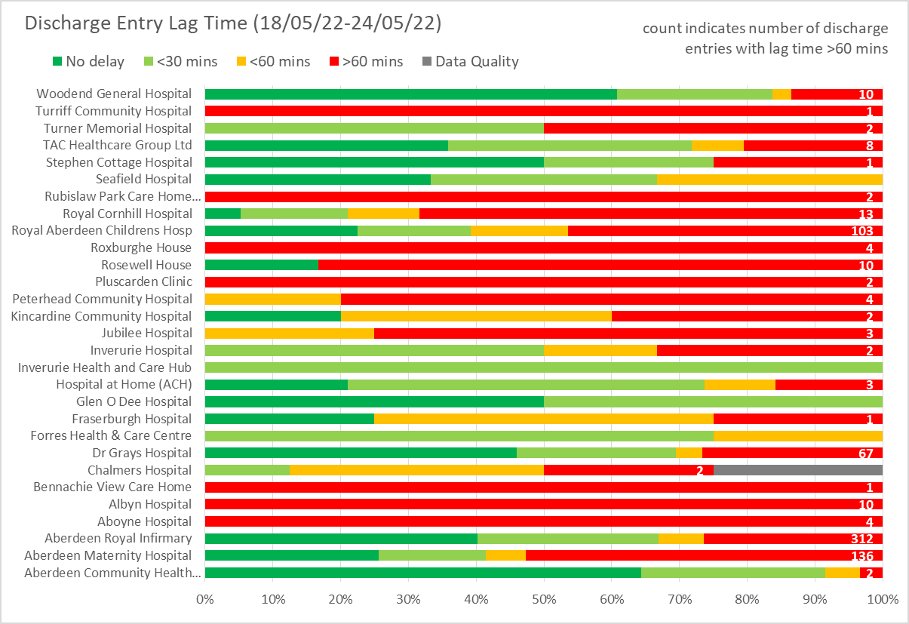
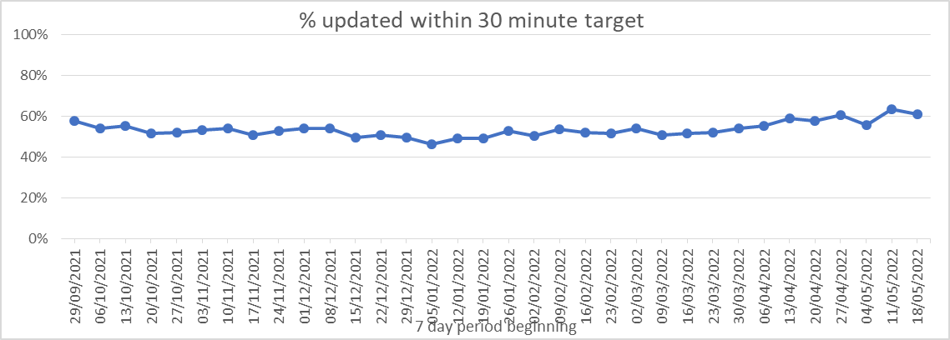
No PDD update this week
RealTime* Bed Management and Planned Discharge Dates
Weekly performance was trending down through Q3 2021/22, but improved through Q4 2021/22 with monthly averages of 49% in January, 52% in February, 52% in March
Improvement has continued with average weekly performance of 57% in April
The latest week’s data provisionally shows 61% of updates within 30 minutes of discharge, although this figure will be revised as further updates are made on the system
RAG status indicates system updates within 30 minutes of discharge
* RealTime defined as within 30 minutes Trend figures may vary slightly from previous reports due to continuous refresh of data

Slide 14
At 24 May:
Care Home occupancy high but stable
Above 60 day average occupancy in City and Shire, below in Moray
Care Home closures due to Covid, previously reported on this slide, are now reported in the next section of this pack

Slide 15
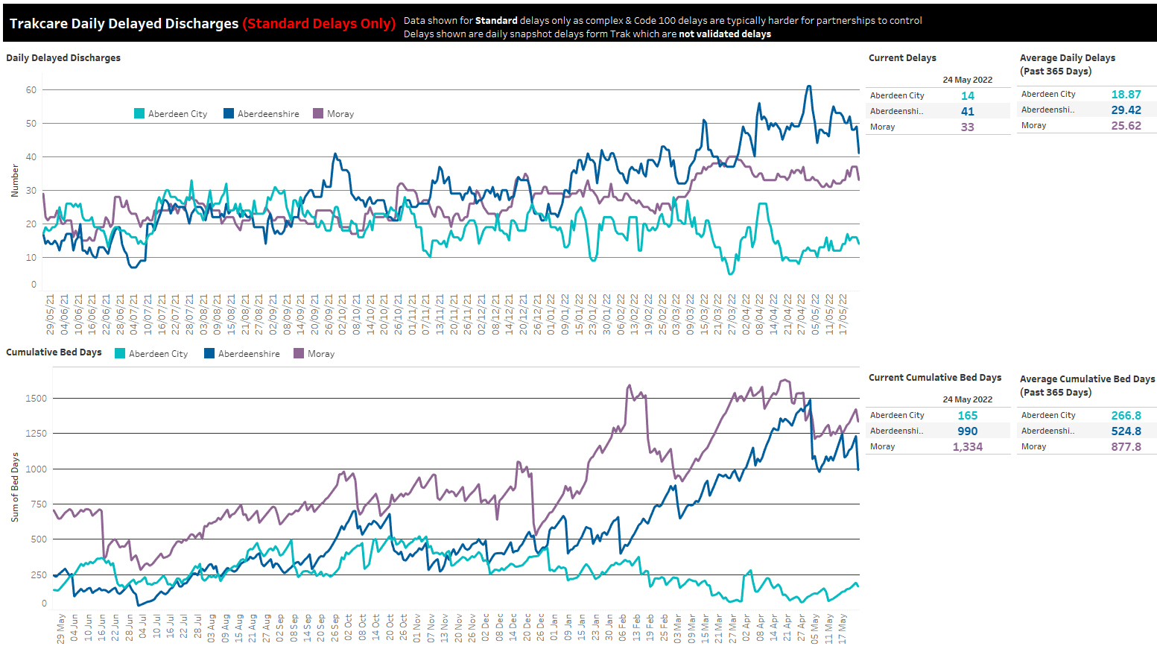
At 24 May:
Large drop in Shire delays after last week’s peak but still significantly above yearly average.
Moray delays have also fallen slightly and are above yearly average. City delays have risen slightly but are still below their yearly average.
Cumulative bed days remain significantly higher than average in Shire and Moray, lower in City.
Steep drop in Aberdeenshire bed days this week.
Moray delays fell sharply last week and then trended upwards throughout the week however have fallen again in the past couple days.

Slide 16
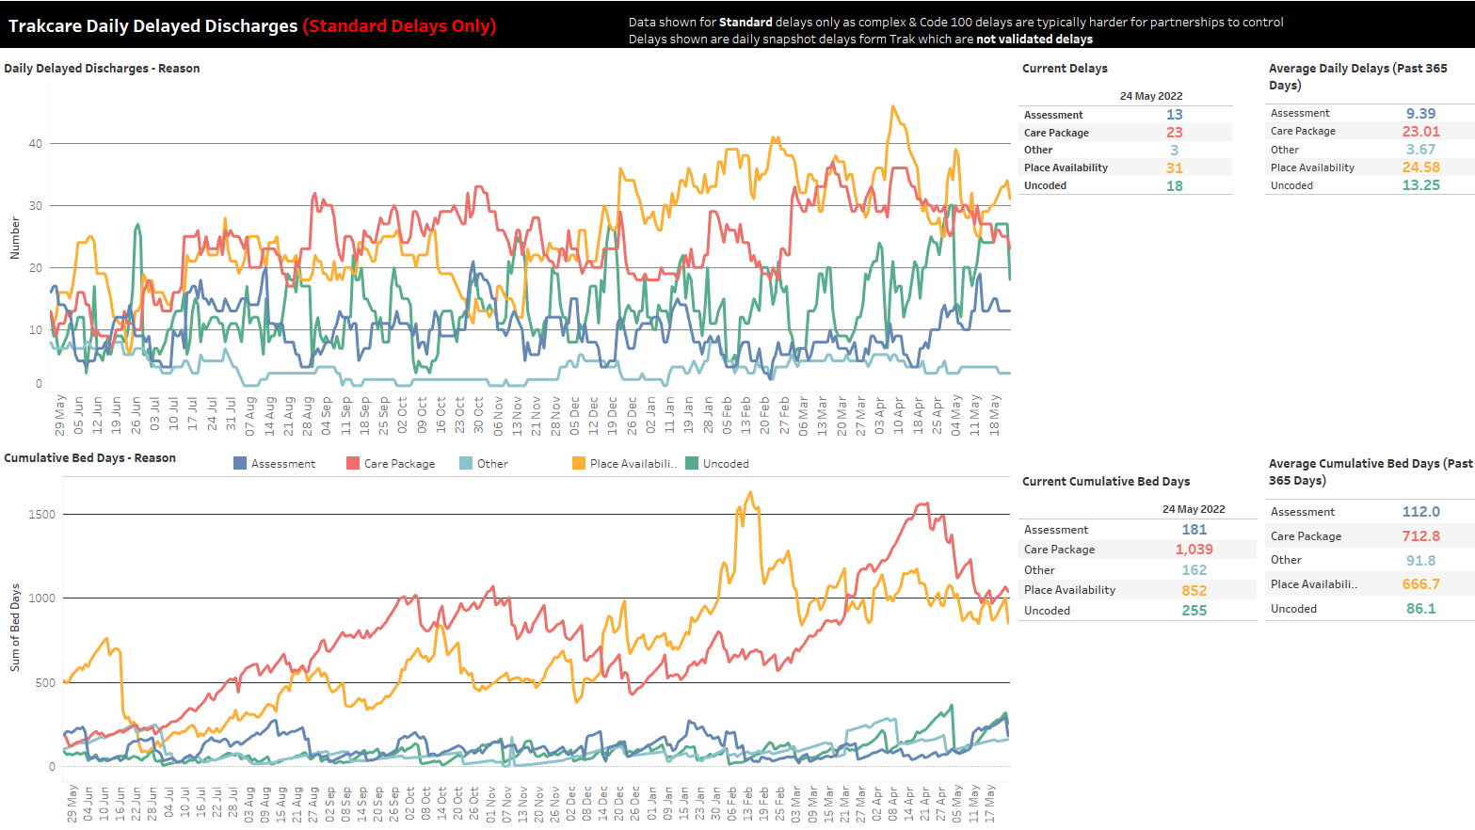
At 24 May:
Current delays remain higher than average for place availability delays.
Care Package delays have been trending downwards the past few weeks and are now equal to yearly average.
Assessment delays have increased to above average.
Due to DD being snapshot at midnight, uncoded delays are over-represented as they are usually coded the following day.
Bed days for Care Packages have fallen significantly since last month but still above yearly average.
Place availability bed days have been trending downwards with a few peaks but also still significantly higher than average
Assessment bed days rose this week but have fallen yesterday.

Slide 17
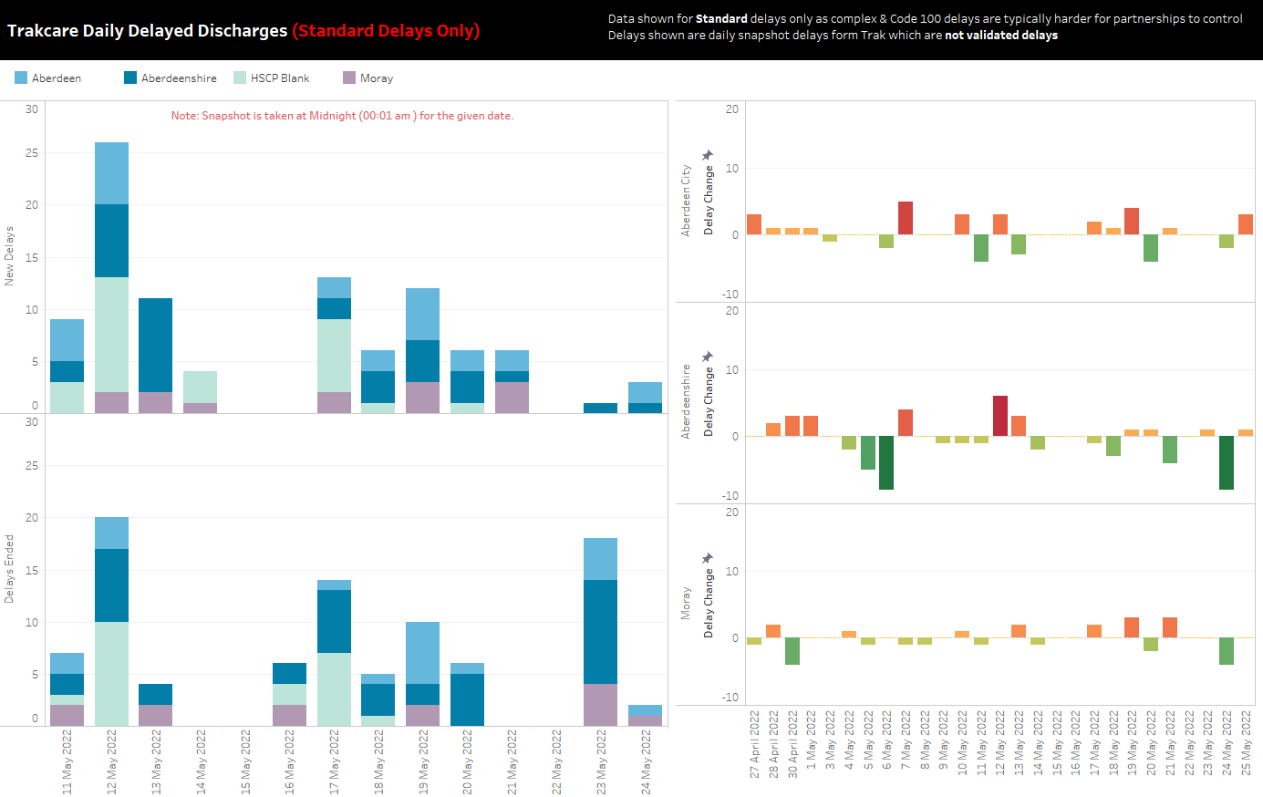

Slide 18
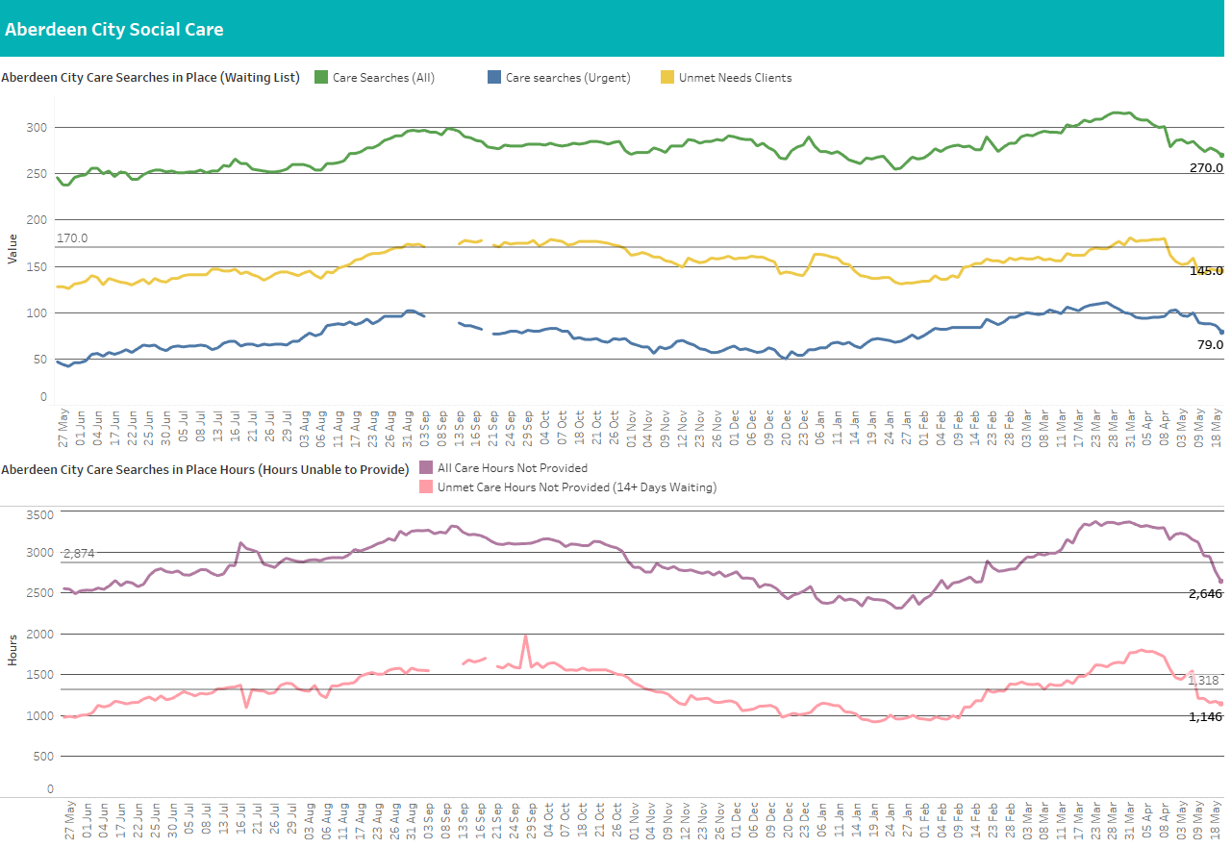
For City, a care search is a record of a case where a care need has been identified but not fulfilled and how many hours of care are required (care search hours). These are weekly hours required per care search.
At 23 May:
Data clean-up at City has led to a drop in reported figures of around 10% beginning Apr
Care searches have fallen to 270, down 8, with 145 currently waiting over 14 days, down 2.
Urgent care searches, currently at 79, down 9.
Weekly hours have also fallen due to data clean-up.
Weekly unprovided hours now 2646, down 297, from last reported and now below the average of 2,874 for the year
1,140 unprovided hours for clients who have waited over 14 days, down another 20 this week, below the average of 1,318 for the year

Slide 19
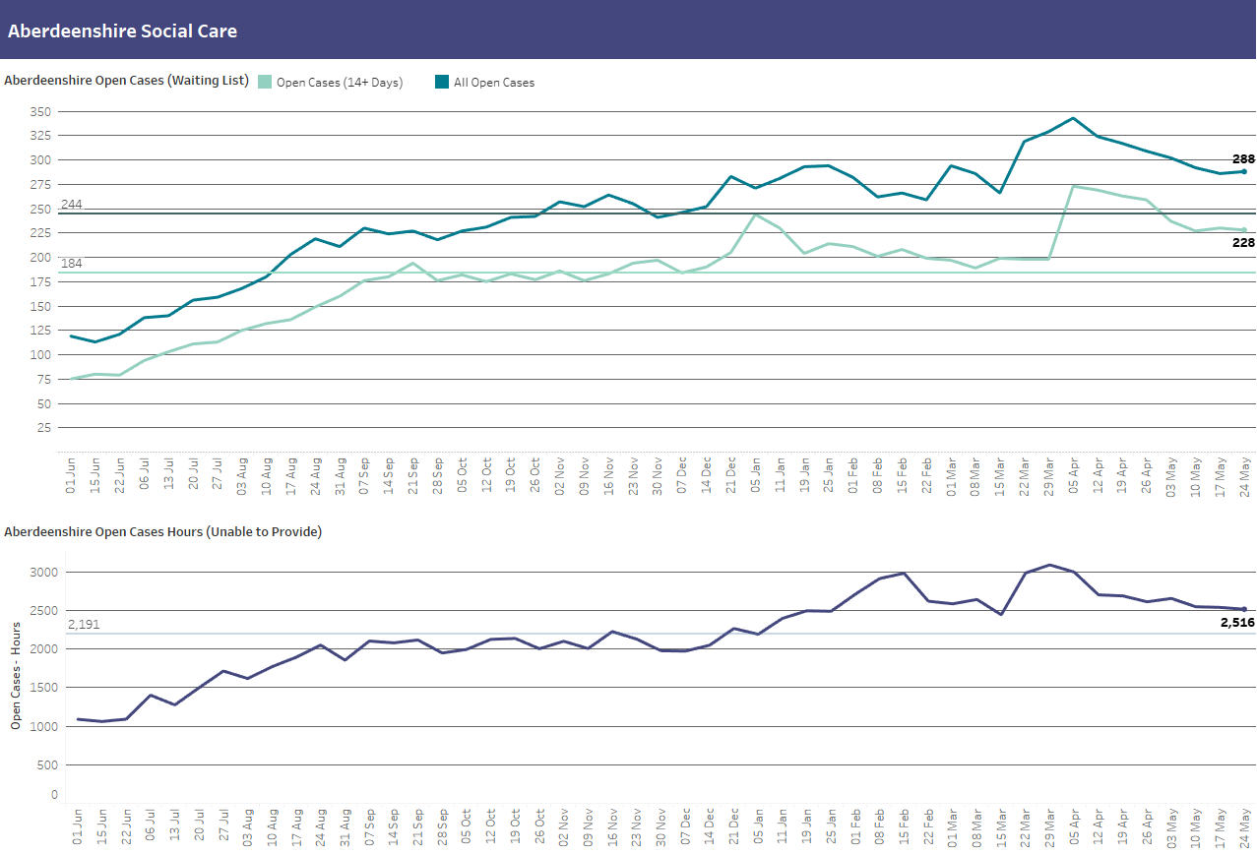
Open cases are where a care need has been identified and recorded on CareFirst. Open Cases hours are the weekly hours assessed as required for each open case. Homecare hours are hours which Shire are currently providing.
At 24 May:
Number of clients waiting for care up 2 this week to 288; above average for year (244)
Open cases have fallen significantly from April highs with unmet needs cases also falling
228 clients waiting over 14 days, defined as unmet need, down 2 significantly above the average for the year (184)
Weekly unprovided hours at 2516, down 24 and significantly above average for the year (2,191).
Unprovided hours have fallen for the past 3 weeks
Homecare Hours Provided are now reported as the redesigned National Support at Home Framework for Supported Living and reported in the Aberdeenshire SMT dashboard.
The Care at Home and Supported Living services have now been merged into one “Support at Home” service – so the numbers will jump next week. However, existing agreements remain as they were but these will gradually be changed over to become Support at Home – any new agreements will be recorded as Support at Home

Slide 20
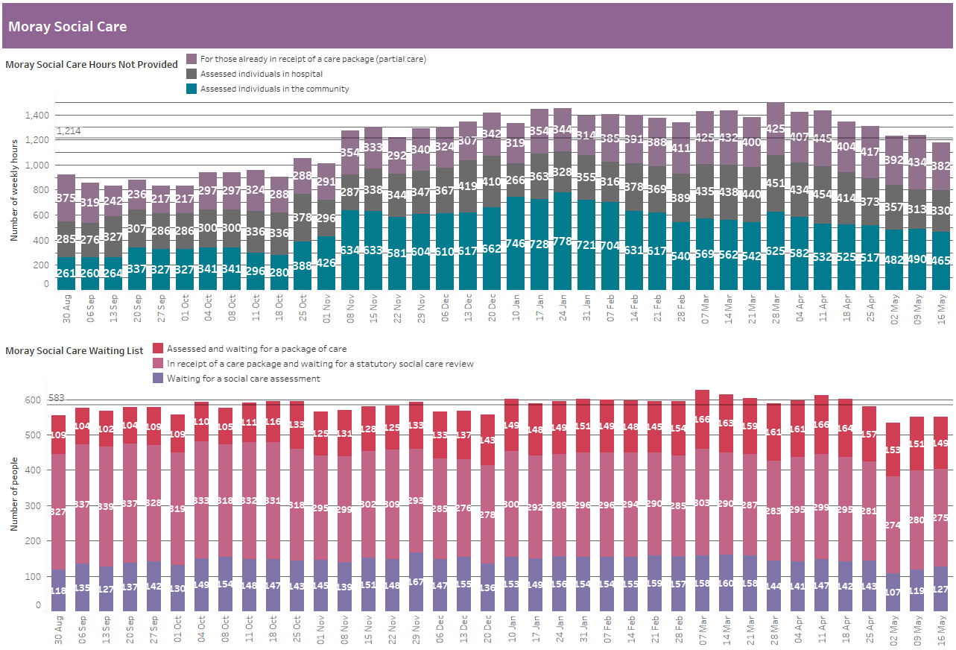
Hours are the number of weekly hours identified as required for that individual. No data is available for length of time on the waiting list to identify unmet need.
At 16 May:
Care hours not provided in the community down 25.
Hours for those in hospital is up 17 this week
1,177 total hours not provided per week (down 60), and below an average of 1,214 since Aug
149 clients assessed, but waiting for care (down 2), above average of 137 since Aug
275 clients awaiting review (down 5), below average of 302
127 clients waiting for a social care assessment (up 8), below average of 145

Slide 21
Objective B
COVID summary

Slide 22
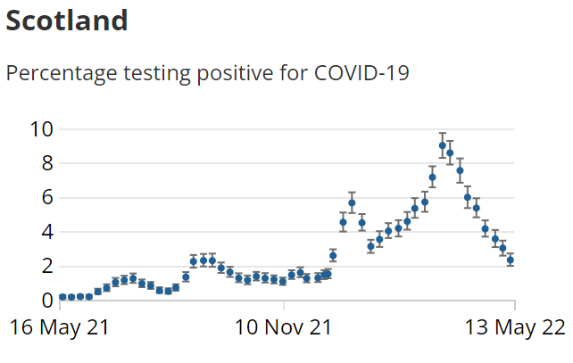
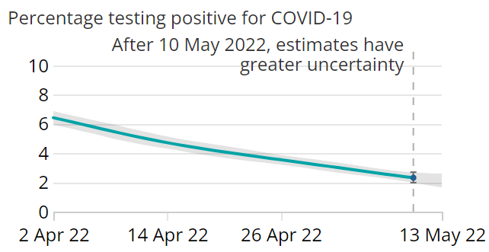
Covid cases across Scotland
Percentage of people testing positive for COVID-19 decreased for the eighth consecutive week
ONS estimate that around 1 in 45 people had COVID-19 in the week ending 13th May 2022
Coronavirus (COVID-19) latest insights - Office for National Statistics (ons.gov.uk)

Slide 23
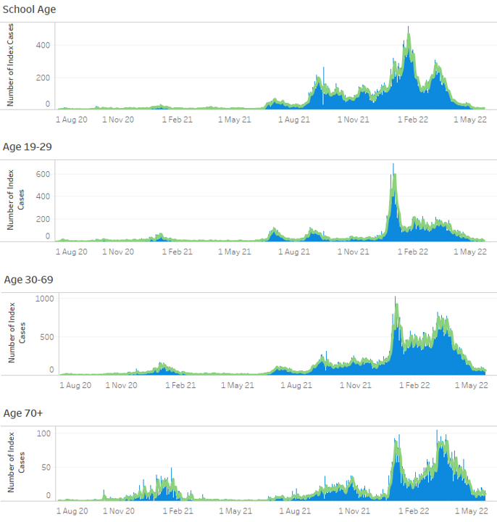
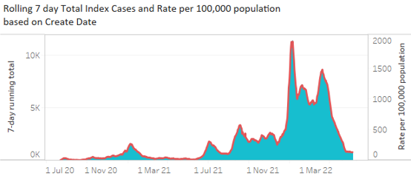
Covid cases across Grampian
Recorded cases continue to fall across all age groups
Local data impacted due to reduced/removed testing criteria
Click here to go to the Illuminate report - Test and Protect Surveillance Report: Index Cases by Create Date - Tableau Server

Slide 24
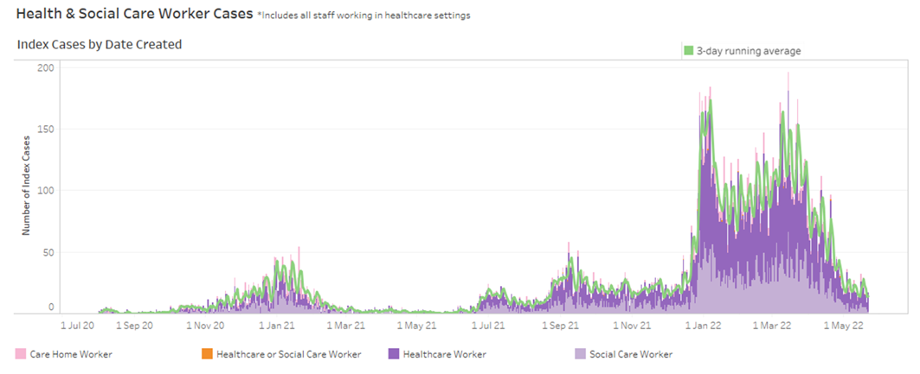
Covid cases: Health and Social Care workers
Case numbers continue to fall

Slide 25
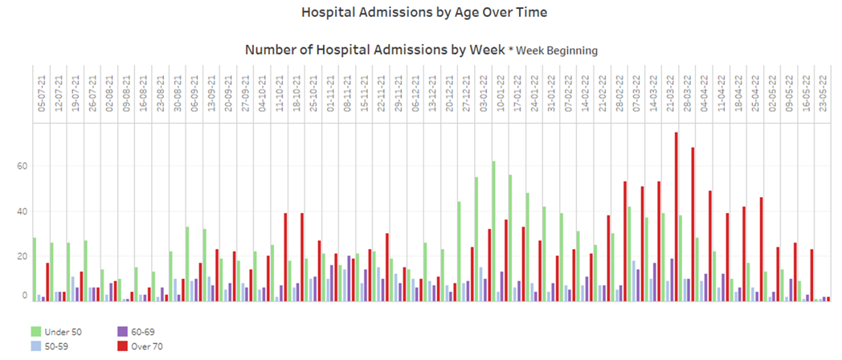
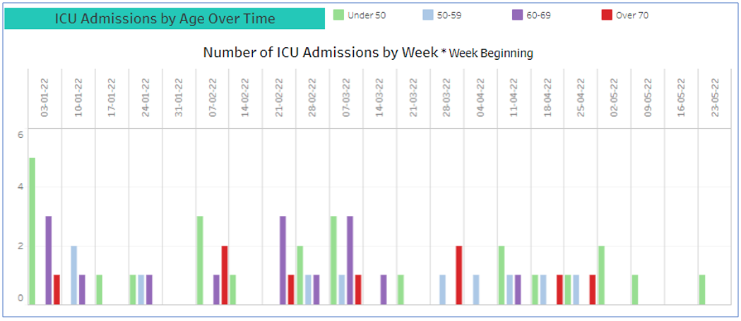
Hospital admissions
Admissions with COVID +ve test are falling in most age categories, over 70s have plateaued
Admissions with COVID +ve test continue to fall
Admissions FOR symptomatic COVID have fallen over the last fortnight
ICU admissions remain low/stable across all age groups

Slide 26
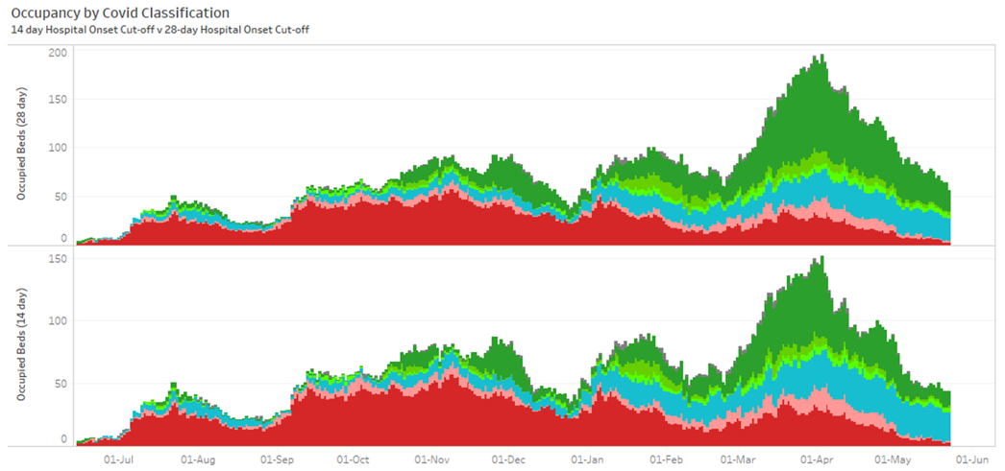
Covid occupancy
Covid occupancy is currently 62 in comparison to 120 four weeks ago
‘Definite/Probable FOR COVID’ occupancy has fallen to 5 (previously 24 in late-April)
There has been a slight spike in the length of stay over the past week
Definite hospital onset = in hospital for at least 14 days prior to testing positive for the first time
Possible hospital onset = in hospital for 8-14 days prior to testing positive for the first time

Slide 27
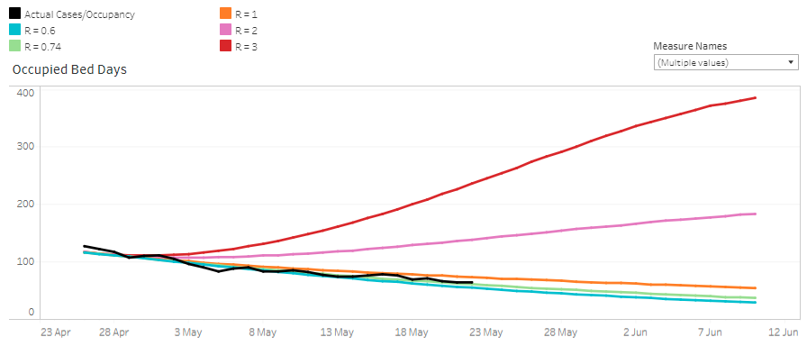
Modelling: occupied bed days
Continuing to follow better case scenario

Slide 28
Covid in Care Homes/Sheltered Housing
2 care homes RED on HPT daily RAG 23rd May (none red on previous sit-rep)
2 red and 20 amber on DPH Care Homes Return 19th May
Care Home closures have previously been reported on our Care Home slide, based on data from TURAS which is self-reported, not assured centrally, and has submission rates below 100%
Reporting is now based on the Daily Care Homes R/G status, whereby care homes are called on a daily basis to check on status: those with Red status would be closed/partially closed to admissions until the outbreak is deemed over or under control

Slide 29
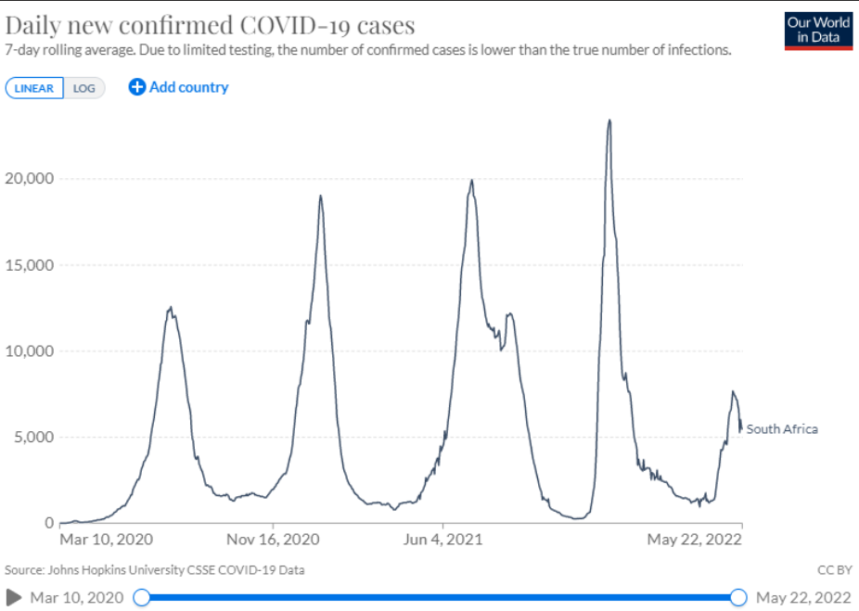
Variants of Concern
Omicron sublineages BA.4 and BA.5 have been classified as variants of concern
Appear to have driven a new wave of Covid infection in South Africa
Suggestion from early data that both are likely to have a growth advantage over BA.2.
Since late April, South Africa has also reported a moderate increase in hospital admissions, although this rise has been significantly lower than that observed during the emergence of Omicron in late 2021

Slide 30
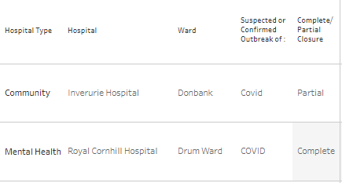
Ward closures due to Covid infection controls
As at 24/05, 1 ward closure and 1 partial ward closure due to Covid infection controls
Based on daily (weekday) SITREPs from Infection Prevention & Control – full detail in Illuminate report Infection Control - Ward Closures for Infection: Infection Control - Ward Closures - Tableau Server

Slide 31
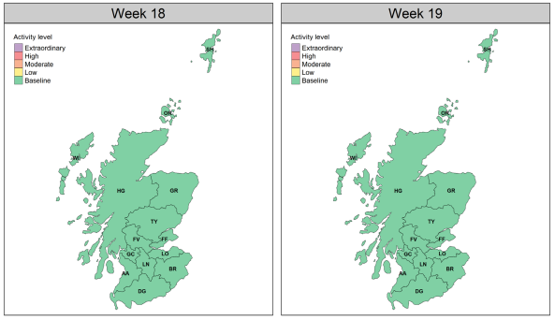
NHS 24 calls for Respiratory symptoms (Scotland-wide)
Week ending 15th May 2022 (week 19)
Maps show NHS24 calls for respiratory symptoms remain at ‘Baseline’ level
Influenza: ‘Baseline’
RSV: ‘Baseline’
Rhinovirus: ‘Low’
Human MPV: ‘Baseline’
Adenovirus: ‘Baseline’
Scotland-wide 69 influenza cases (down from 75 in week 17)
Click here to visit the PHS full report - https://publichealthscotland.scot/publications/weekly-national-seasonal-respiratory-report/weekly-national-seasonal-respiratory-report-week-19

Slide 32
Objective C
Protecting critical services & reducing harm

Slide 33
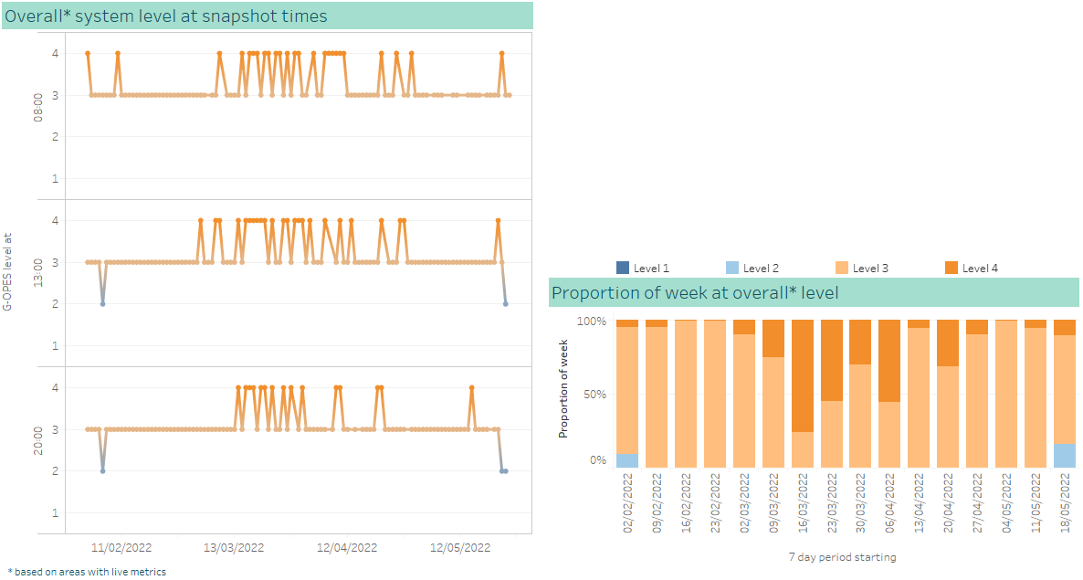
Overall G-OPES system pressure metrics
The overall system has predominantly been at level 3 for the week to 24th May
The system reported at level 2 on three occasions earlier this week, the first level 2 reports since February
Royal Cornhill Hospital has been at level 4 for over half the week
Full detail for all areas can be found in the Illuminate report - G-OPES Metrics History

Slide 34
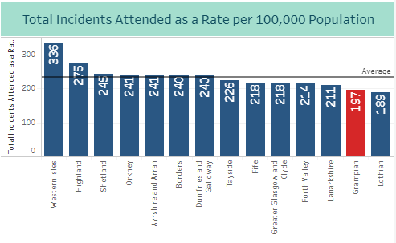
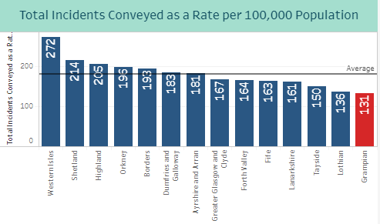
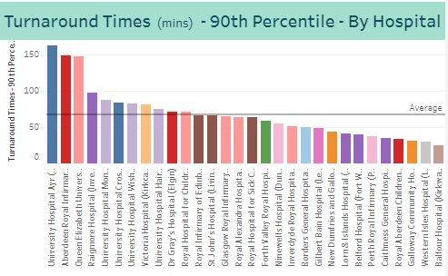
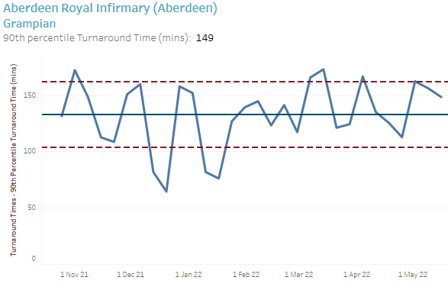
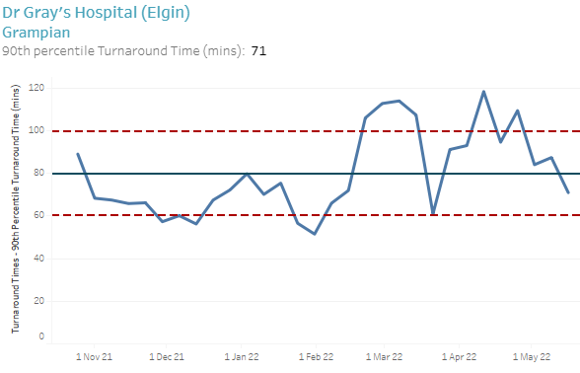
SAS – Weekly Operational Statistics
Click here to go to the Illuminate Dashboard - SAS - Weekly Operational Statistics: SAS - Weekly Operational Statistics - Tableau Server
Grampian’s total incidents attended as a rate per 100,000 population increased from 189 to 197. The Scottish average increased from 229 to 235.
Grampian’s total incidents conveyed as a rate per 100,000 population increased from 127 last week to 131. The Scottish average increased from 172 to 180.
79% of incidents were attended in Grampian, a fall from 81% the previous week (79% across Scotland). Of these attendances in Grampian, 67% were conveyed to hospital, the same level as the last two weeks. The Scottish rate for attendances conveyed to hospital is 74%.
The 90th Percentile turnaround time for ARI fell slightly, again from 156 minutes last week to 149 minutes. Dr Gray’s has fallen, from 87 minutes last week to 71 minutes, the lowest level in two months. The Scottish average has fallen slightly to 67 minutes.
Data Sourced from SAS weekly statistics publication - https://www.scottishambulance.com/publications/unscheduled-care-operational-statistics/

Slide 35
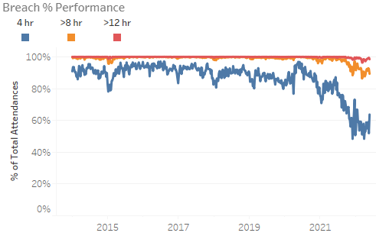
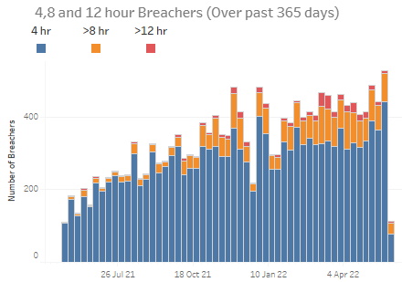
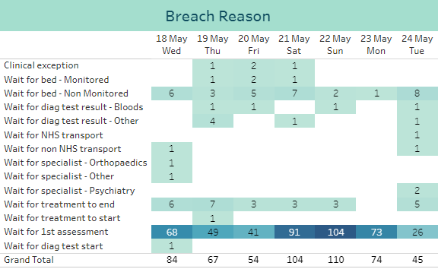
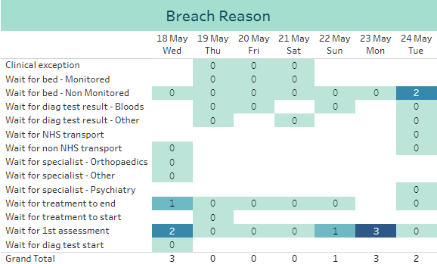
A&E Performance – ARI
the number of 8 hour breachers increased six-fold through 2021, from an average of 10 per week in Q1 to an average of 60pw in Q4
in Q1 2022 this increased further to an average of 80pw
there were 101 8-hour breachers in the last 7 days (compared to 73 the previous week)
weekly 4 hour performance fell last week, to 52% (from 59% the week before)
daily variation in the last 7 days: 36% Sat 21st (including 28 breachers between 6pm and 9pm); 70% Tue 24th
primary 4 hour breach reason remains ‘Wait for 1st assessment’
the number of 12 hour breachers increased from an average of 1 per week in Q1 2021 to an average of 1 per day in Q4
since the beginning of March, this has increased to an average of 3 per day
there have been 9 12-hour breachers in the last 7 days, the same level as the previous week
4 hours
12 hours
primary 12 hour breach reason remains ‘Wait for 1st assessment’
To view the dashboards click here - A&E SitRep Dashboard: A&E SitRep - Tableau Server USC Weekly Report: Page 1 - Tableau Server

Slide 36
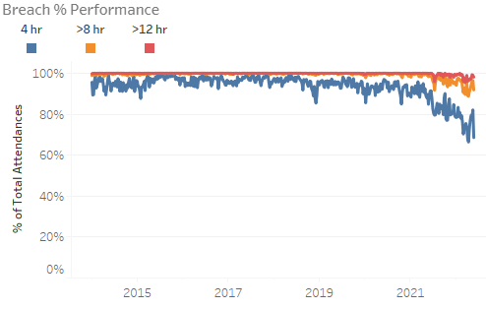
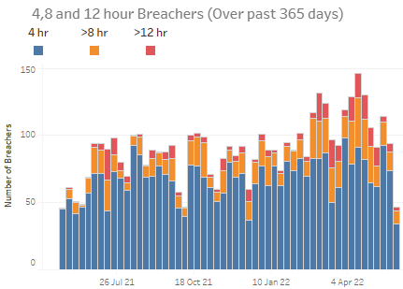
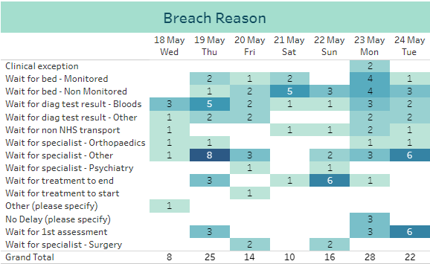
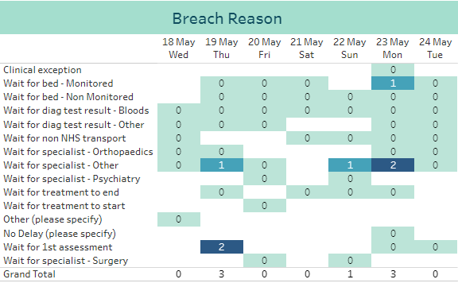
A&E Performance – Dr Gray’s
the number of 8 hour breachers increased seven-fold through 2021, from an average of 2.5 per week in Q1 to an average of 19pw in Q4
in Q1 2022 this increased further to an average of 25pw
there have been 28 8-hour breachers in the last 7 days (compared to 18 the previous week)
weekly 4 hour performance improved to 82% last week (from 79% the week before)
daily variation in the last 7 days: 89% Wed 18th; 66% Mon 23rd (including 16 breachers between 6pm and midnight)
primary 4 hour breach reason was ‘Wait for specialist - Other’
the number of 12 hour breachers increased from an average of 1 per month in the first half of 2021 to an average of 4 per week in Q4
since the beginning of March, this has increased to an average of 2 per day
there have been 7 12-hour breachers in the last 7 days (compared to 4 the previous week)
4 hours
12 hours
primary 12 hour breach reason was ‘Wait for specialist - Other’
To view the dashboards click here - A&E SitRep Dashboard: A&E SitRep - Tableau Server USC Weekly Report: Page 1 - Tableau Server

Slide 37
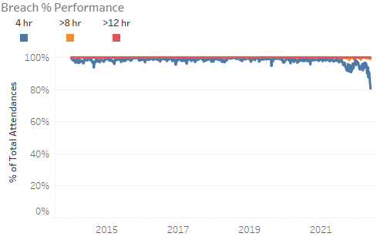
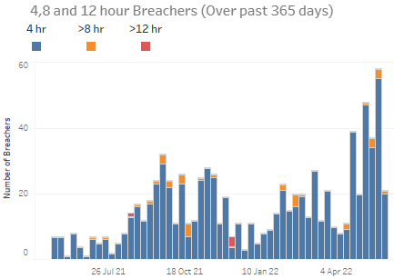
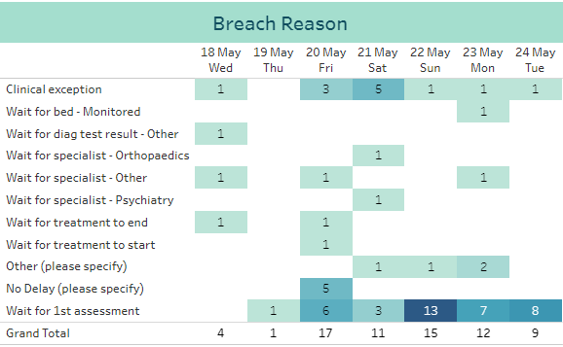
A&E Performance – RACH
there were no 8 hour breachers in Q1 2021; with slightly increasing numbers through the year with 8 hour breaches in 5 weeks in Q4
the position has improved in Q1 2022
there were 4 8-hour breaches in the last 7 days (compared to none the previous week)
weekly 4 hour performance fell to a new low of 86% last week, from 91% the week before
earlier this year attendances averaged 324 per week; recent weeks have seen an almost 20% increase to an average 383 attendances per week over the last 5 weeks, with over 400 attendances in the last two weeks.– an almost 20% increase
daily variation in the last 7 days: 98% Thu 19th, 73% Sat 20th
primary 4 hour breach reason remains ‘Wait for 1st assessment’
4 hours
To view the dashboards click here - A&E SitRep Dashboard: A&E SitRep - Tableau Server USC Weekly Report: Page 1 - Tableau Server

Slide 38
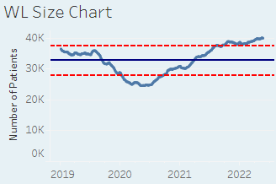
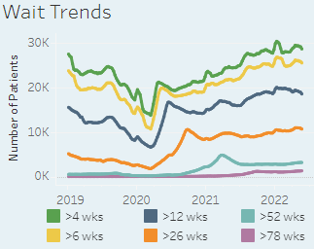
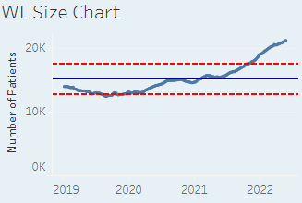
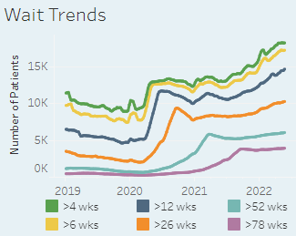
Waiting Times Overview
Click here - Waiting Times Dashboard: Waiting List KPIs - Tableau Server
Outpatients (consultant-led)
Inpatients
The list size has decreased by 131 patients this week
The proportion of patients waiting over 12 weeks has decreased again, from 47.3% last week to 46.4% this week
Of the top 20 longest waits, GP Minor Surgery accounts for 19 and Urology for 1 patient
The longest waiting patient this week is a Urology patient waiting 1223 days
The list size has increased by 106 patients, the eighth consecutive weekly increase
The proportion of patients waiting over 12 weeks increased, from 68.7% last week to 69.3%
Of the top 20 longest waits, Urology accounts for 8, Plastic Surgery for 7, General Surgery 3 and Gynaecology for 2 patients
The longest waiting patient this week is a Plastic Surgery ESCatS 3 patient waiting 1818 days

Slide 39
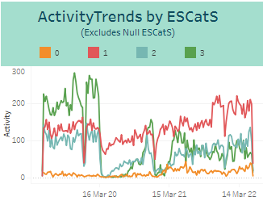
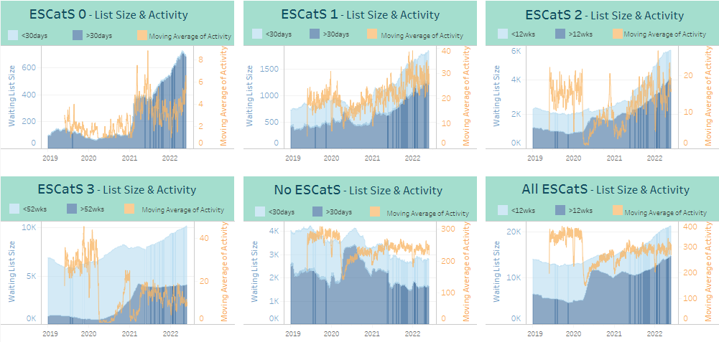
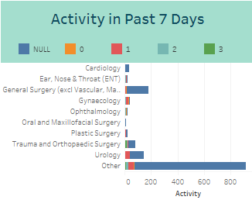
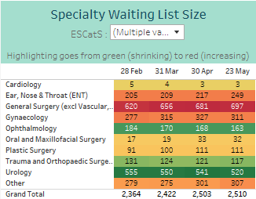
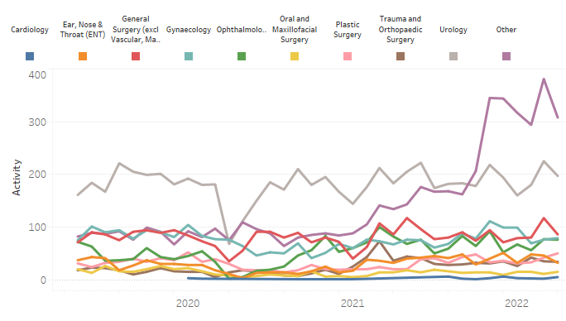
ESCatS Performance
Click here to go to the Tableau Illuminate Dashboard - Elective Care Overview: Elective Care Overview - Tableau Server
ESCatS 1 activity continues to fluctuate around a plateau level, although at a higher overall level than in 2019
ESCatS 0&1 Waiting List size continues to increase across most specialties, but particularly so for General Surgery and ENT, with some increase in Gynaecology
ESCatS 0&1 Activity Trend

Slide 40
Cancer Performance
Click here to go to the Tableau Illuminate Dashboard - Elective Care Overview: Elective Care Overview - Tableau Server
Current Q2 performance against the 31 day standard is 93%
Performance against the 31 day standard for Q1 2022 was 92%
Performance against the 31 day standard dropped throughout 2021
Having previously achieved the 95% target, performance fell from 94.6% in Q3 to 91% in Q4 2021, below the 95% target for the second successive quarter
In Q4 2021, Grampian was one of only two mainland boards not to meet the 95% target
Current Q2 performance against the 62 day standard is 74%
Performance against the 62 day standard Q1 2022 was 74%
Following improvement from Q1 to Q2 2021, performance against the 62 day standard then dropped through the rest of the year
Performance fell from 77% in Q3 to 73.4% in Q4 2021, with the 95% target not yet being achieved
In Q4 2021, Grampian reported the second lowest performance of the mainland boards
Note: current quarter ongoing/incomplete

Slide 41
Mental Health Performance
Compliance at 93% for March 2022
Performance consistently meeting 90% target through 2022, and 2021 with the exception of April 2021.
Compliance fell to 90% in October, with lower activity levels.
Activity levels have been steadily rising through the first 3 months of 2022 and are 50% higher than for the same period last year
Referrals at a consistent level of around 340 per month from September through to January, however dropped by around 1/3 in February
Percentage Compliance of all Psychological Therapies Patients Treated by Month
Compliance at 82.5% for March
Performance for February was 75.6%
Performance just below the 90% target from July 2021, with a drop in November
To view the dashboards click here - CAMHs Monthly Reports: CAMHs - Treated/Seen - Tableau Server All Ages PT & CAMHs Reports: Treatment - 18Wk Target Trends - Tableau Server

