Slide 1

NHS Grampian System Pressures
Agenda Item 5, Appendix 1
Data as at 14 September 2022

Slide 2
Weekly system summary update
GOPES metrics | While the system was mainly at level 3 for the week to 13th September, there was an increase in level 4 reporting (to the highest level since the start of July). MUSC reported level 4 on all but two occasions in the last week
Staff absences | The steep downward trend in Covid-positive absences continues; annual leave has been decreasing since mid-July. Caution should be applied to the most recent weeks’ data as there is a lag in absence data being input
SAS Turnaround Times | The 90th percentile turnaround time increased at ARI to a new high of 223 minutes, but fell again at Dr Gray’s (to 87 minutes, just above the Scottish average). The number of ambulances waiting at ARI was exceptionally high on 12th September, with 15 ambulances waiting at 5pm
A&E Performance | Weekly 4-hour performance fell at ARI to 48.2% at ARI, but improved to 76.1% at Dr Gray’s and to 90.9% at RACH. Very high numbers of 8- and 12-hour breaches recorded at ARI in the last 7 days, particularly on 12th & 13th September
Elective care | The Outpatient list size has fallen; the proportion of patients waiting over 12 weeks has increased for the sixth consecutive week, to 47.2%; the proportion waiting over 104 weeks has also increased slightly. The TTG Inpatient list size has increased; the proportion of patients waiting over 12 weeks has fallen slightly again, to 76.6%; the number of patients waiting over 104 weeks continues to decrease
Cancer | Current Q3 2022 performance against the 31-day standard is 95%, continuing the improvement through Q1 and Q2. Current Q3 2022 performance against the 62-day standard is 73%, well below the 95% national standard
Mental Health | Not updated this week
Ward safety status | Proportion of wards reporting a red or amber RAG status increased to 50.6%, with red RAG status reports increasing to 18.9% last week (the highest level since early July
Hospital bed occupancy | Remains at very high levels across NHSG estate with some areas at, near, or over 100%. ARI is showing indication of near 100% in the last two days. At 14 September, 23 patients in ICU (including 1 Covid patient). The maximum number of beds available to use across all Grampian hospitals has increased slightly to 1812 (Dr Gray’s and Moray bed numbers remain under review)
Care home occupancy | Continues at high but stable levels across Grampian. 2 homes closed to admissions and 1 with control measures in place. It should be noted that returns to TURAS have been falling, especially in Moray
Delayed Discharges | Shire delays remain high, Moray delays are relatively stable this week, City delays continue a general downward trend. ‘Place availability’ delays remain very high; 56% of the associated cumulative bed days are in Shire. The ‘Care package’ delays fall from late July has been maintained, with 72% of the associated cumulative bed days in Moray
Social care | Hours not provided have increased slightly in City and Moray and decreased slightly in Shire
Covid | Local case data shows a further fall in recorded positive tests however case numbers should continue to be interpreted cautiously. Hospital admissions and occupancy increased through early September from the recent low at the end of August. As at 14/09, 1 covid patient in ICU. Number of ward closures due to Covid is 1

Slide 3
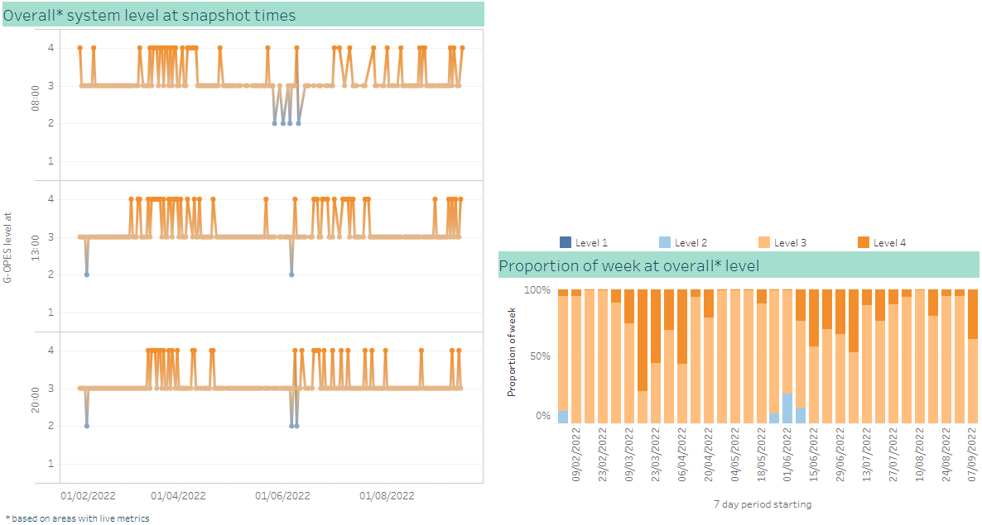
Overall G-OPES system pressure metrics
Increase in level 4 over the last week
The overall system has mainly been at level 3 for the week to 13th September, with an increase in level 4
Highest proportion of level 4 reporting since the start of July
MUSC reported level 4 on all but two occasions in the last week
ISCP and Royal Cornhill Hospital reported level 4 on multiple occasions in the last week

Slide 4
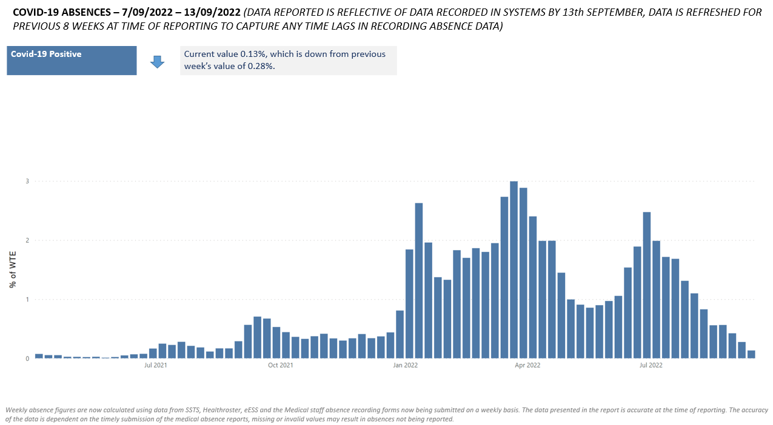
Workforce – COVID-19 absences
Continued downward trend
From the 1st September current Covid special leave will be transitioned to sick leave (Covid related illness). From 1st September onwards only those with a new positive LFD will be granted special leave until such time as a test is negative, and then if the employee is still absent it will be recorded as sick leave.
As there is no longer a breakdown of the various Covid absence reasons, this chart now only shows Covid-19 positive absence data; all other Covid-19 related absences are included within sickness leave on the next page

Slide 5
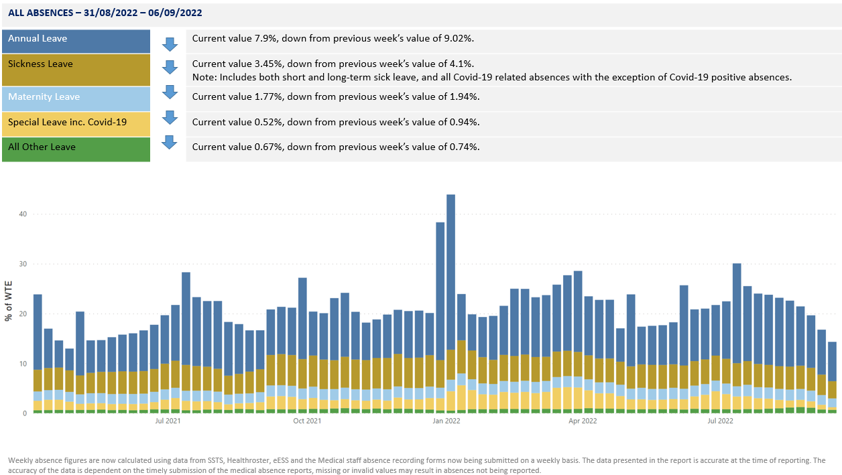
Workforce – all leave
Annual leave has been decreasing since July

Slide 6
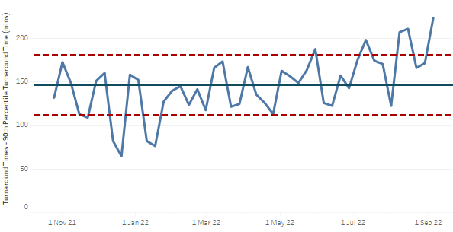
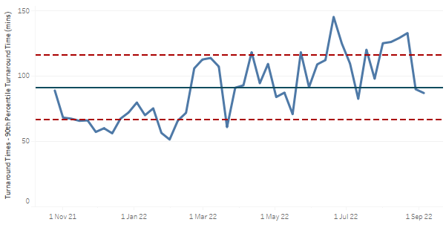
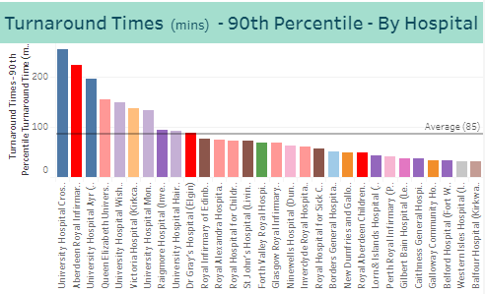
Scottish Ambulance Service turnaround times
ARI 90th percentile turnaround time at a new high last week
ARI 90th percentile ambulance turnaround time increased, from 171 minutes to a new high of 223 minutes
Dr Gray’s 90th percentile ambulance fell again, from 90 to 87 minutes
ARI and Dr Gray’s 90th percentile ambulance turnaround times remain above the Scottish average (85 minutes), although Dr Gray’s is now just above this level following recent improvement

Slide 7

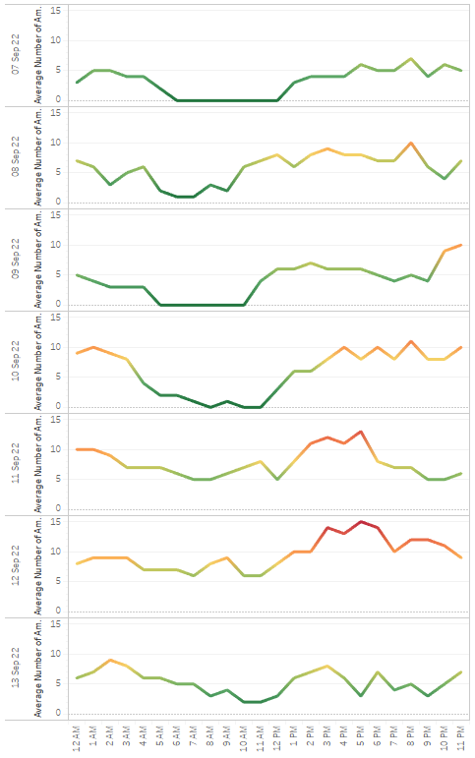
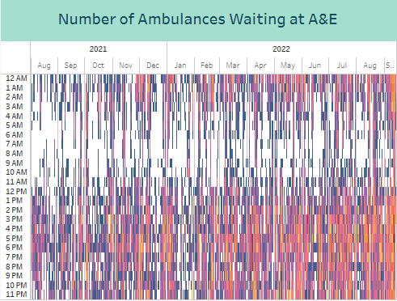
Ambulances Waiting at ARI
15 ambulances waiting at ARI on Monday
The number of ambulances waiting at ARI was exceptionally high on Monday 12th September late-afternoon, with 15 ambulances waiting at 5pm
This level has only been observed on 3 previous occasions this year
These very high numbers of ambulances waiting usually occur between 3pm and 8pm

Slide 8
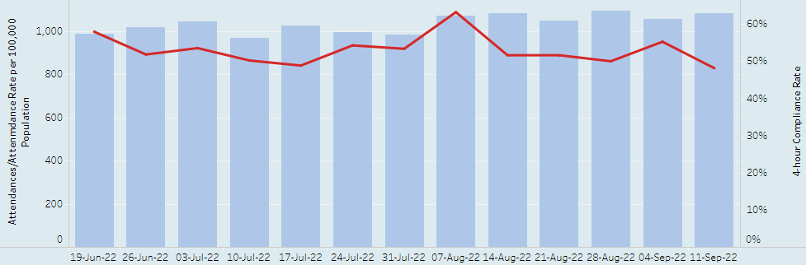
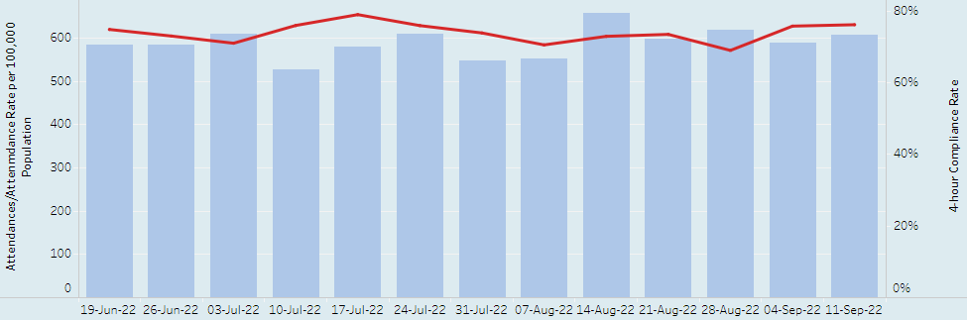
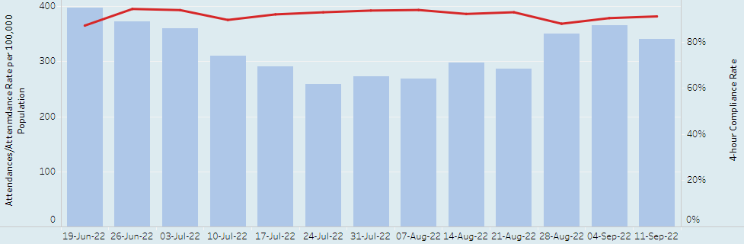
A&E 4 hour performance
Performance fell at ARI; very high number of 8- and 12-hour breachers at ARI
ARI performance fell, from 55.3% to 48.2%
primary 4 hour breach reason remains ‘Wait for 1st assessment’
216 8-hour breaches in the last 7 days, an increase from 94 the previous week and the highest number recorded in a 7-day period
52 12-hour breaches in the last 7 days, an increase from 11 the previous week
  the second-highest level of 12-hour breaches observed, and includes 14 on Mon 12th and 16 on Tue 13th
Dr Gray’s increased slightly, from 75.7% to 76.1%
primary 4 hour breach reason is ‘Wait for 1st assessment’
31 8-hour breaches in the last 7 days, a decrease from 51 the previous week and continuing the trend observed since mid-August
10 12-hour breaches in the last 7 days, an increase from 17 the previous week
RACH increased slightly, from 90.1% to 90.9%
primary 4 hour breach reason remains ‘Wait for 1st assessment’
1 8-hour breach in the last 7 days, the same level as the previous week
no 12-hour breaches in the last 7 days, the same level as the previous week

Slide 9
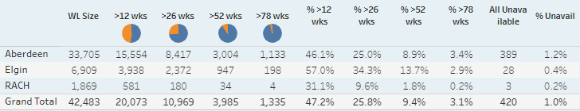
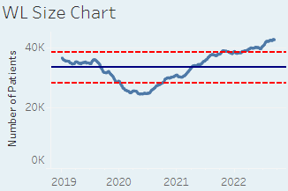
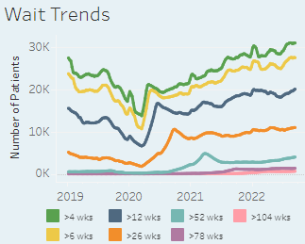
Elective Care – consultant-led Outpatients
Proportion waiting over 104 weeks has increased
The list size has decreased by 105 patients since last week
The proportion of patients waiting over 12 weeks has increased for the sixth consecutive week, to 47.2%
The number of patients waiting over 104 weeks is 619 (1.46% of the waiting list), a slight increase from 602 the previous week (1.41% of the waiting list)
The proportion of patients unavailable (all reasons) remains at 1.0%
The longest waiting patient has been waiting for 1,335 days (GP Minor Surgery) and is not yet booked to come in
Only one of the 20 longest waiting patients has been booked to come in
The longest waiting urgent/USC patient has been waiting 598 days (Urology) and is not yet booked to come in
16 of the 20 longest waiting urgent/USC patients have been booked to come in
Monthly activity levels continue to fluctuate; having fallen through June and July they increased in August but remain lower than 2019 levels
Specialties to note:
Vascular Surgery waiting list size has more than doubled since the end of March, from 173 to 379 patients. 24% of patients are waiting over 12 weeks and all but 2 of the 20 longest waits are booked to come in.
ENT has 3210 patients (68% of the list) waiting over 12 weeks, and the overall list size continues to rise steadily. 810 patients have waited longer than 52 weeks, and 61 patients have waited longer than 104 weeks. 13 of the 20 longest waiting patients have been booked to come in; none of the 20 longest waiting paediatric patients have been booked to come in yet.

Slide 10
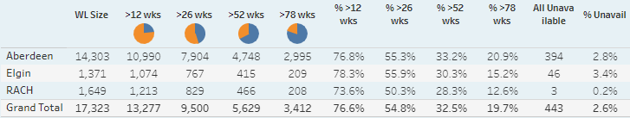
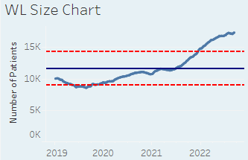
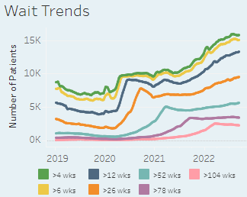
Elective Care – TTG Inpatients (note change from previously all inpatients)
Number waiting over 104 weeks continues to decrease
The list size has increased by 98 patients since last week, a second consecutive weekly rise
The proportion of patients waiting over 12 weeks has fallen slightly for the second consecutive week, to 76.6%
The number of patients waiting over 104 weeks is 2,257 (13.0% of the waiting list), a slight fall from 2,278 the previous week (13.2% of the waiting list)
The proportion of patients unavailable (all reasons) is 2.6%
The longest waiting patient has been waiting for 1,930 days (Plastic Surgery ESCatS 3) and is not booked
2 of the 20 longest waiting patients have been booked
The longest waiting urgent/USC patient has been waiting 580 days (Cardiology), and is not booked to come in
6 of the 20 longest waiting urgent/USC patients have been booked
ESCatS 1 activity had been increasing but fell in early July; it has been increasing through August. The overall ESCatS1 activity level remains higher than in 2019
Specialties to note:
Orthopaedic TTG waiting list size has fallen slightly since early July, however 83% of patients are now waiting longer than 12 weeks. There are 1342 patients waiting longer than 52 weeks, and 302 patients waiting longer than 104 weeks. Only 2 of the 20 longest waiting patients are booked to come in; 5 of the 20 longest waiting ESCatS 1 patients have been booked.
Gynaecology has 51% of patients waiting longer than 52 weeks and 24% waiting longer than 104 weeks. All of the 20 longest waiting patients have waited for over 3 years; only 2 have been booked to come in.

Slide 11
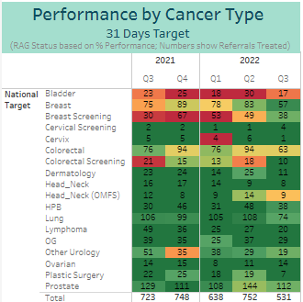
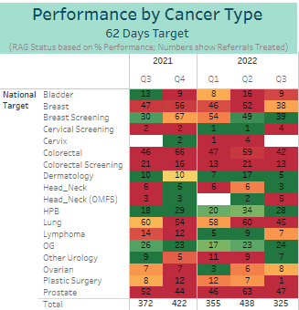
Cancer waiting times performance
Improvement in 31-day performance; 62-day performance below national standard
Current Q3 2022 performance against the 31 day standard remains at 95%
Performance against the 31 day standard for Q1 2022 was 92%, and for Q2 2022 was 94%
Current Q3 2022 performance against the 62 day standard remains at 73%, well below the national standard of 95%
Performance against the 62 day standard for Q1 2022 was 74%, and for Q2 2022 was 73%

Slide 12
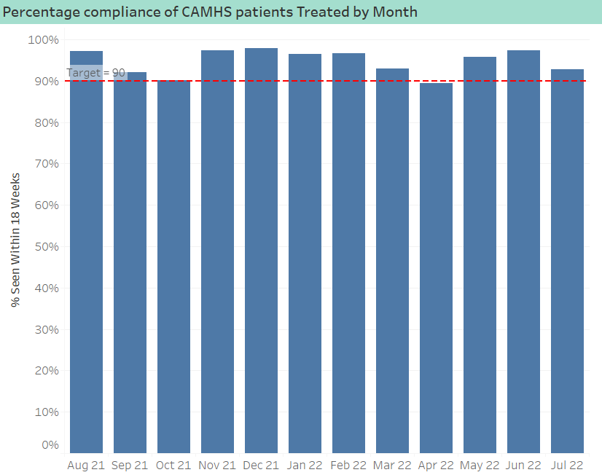
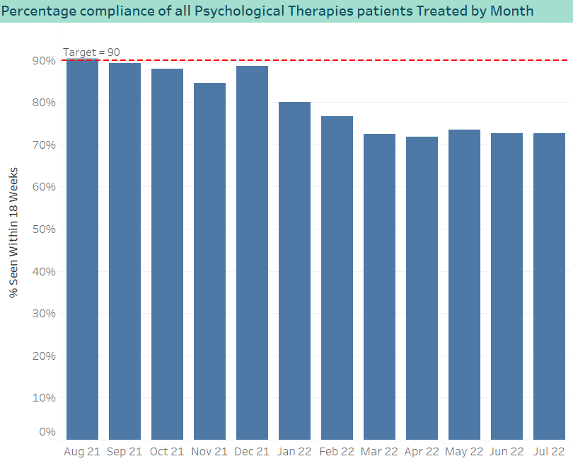
Mental health waiting times performance
No update this week
After falling below the 90% target in April 2022, performance has returned to above target
Compliance at 92.9% for July 2022, a drop from 97.3% in June
Performance remains consistently below the 90% target, having fallen below 80% in February 2022
Compliance at 72.6% for July 2022, the same level as June

Slide 13
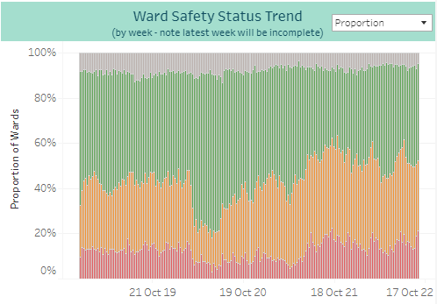
Ward Safety Status
Increase in red RAG status last week
The overall trend data shows for the week beginning 4 September 50.6% of wards reported a red or amber RAG status, an increase from 49.4% the week before
Red RAG status reports have increased to 18.9% from 13.6% the previous week, and are now at the highest level since early July

Slide 14
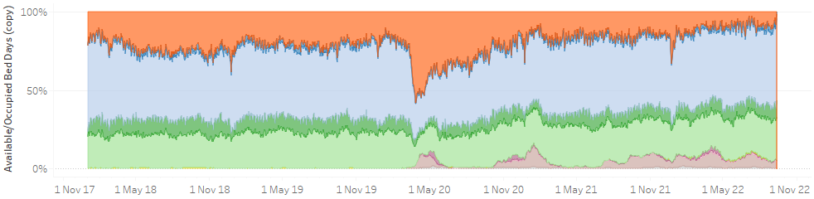
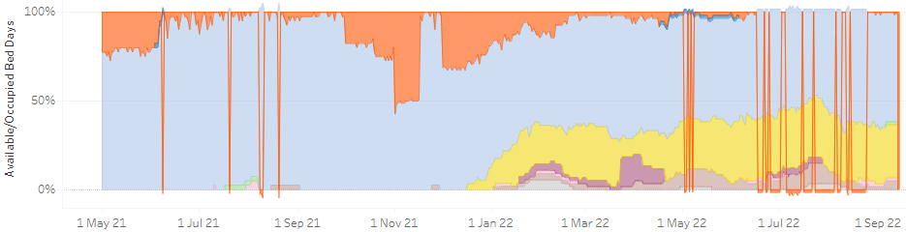
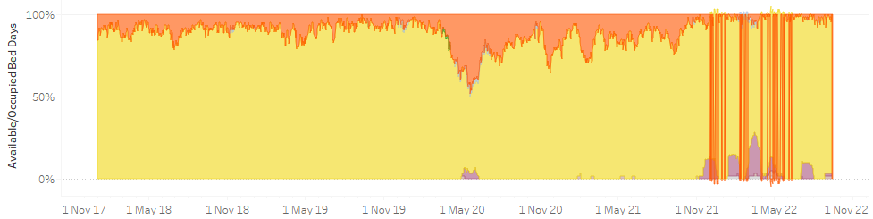
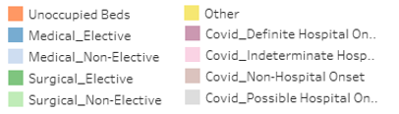
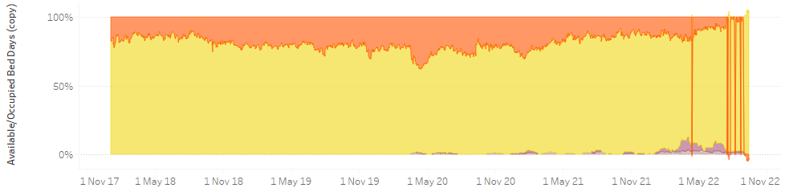
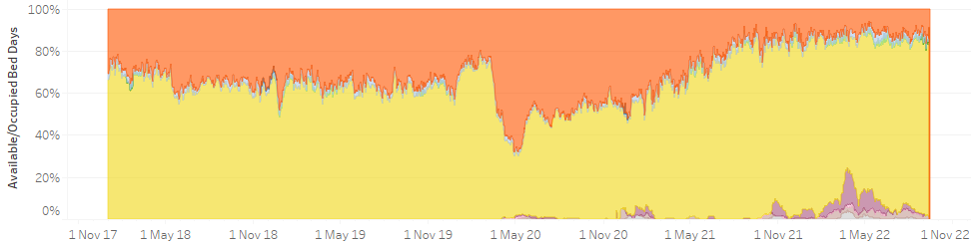
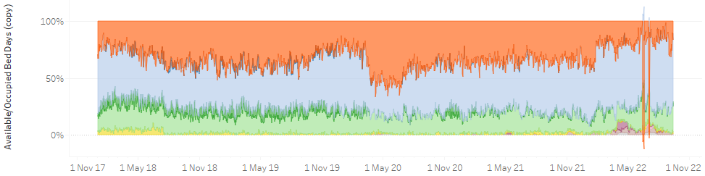
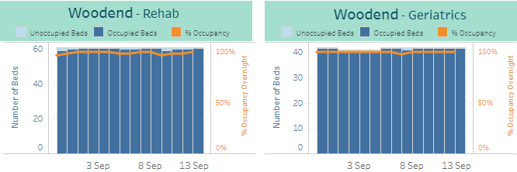
Hospital bed occupancy
Remains at very high levels with some areas at, near, or above 100%
ARI occupancy remains at very high levels, with an indication of near 100% in the last two days
Rosewell House occupancy remains very high, and continues to exceed 100% on occasion
Moray community hospital occupancy remains very high, near 100%
Royal Cornhill occupancy remains very high, exceeding 100% through September
Aberdeenshire community hospital occupancy remains high
Dr Gray’s occupancy remains very high; ward 7 reopened at the start of September
Woodend community occupancy remains very high, at or near 100%
RACH continues to have reasonable capacity available
Dr Gray’s and Moray bed numbers are currently under review

Slide 15
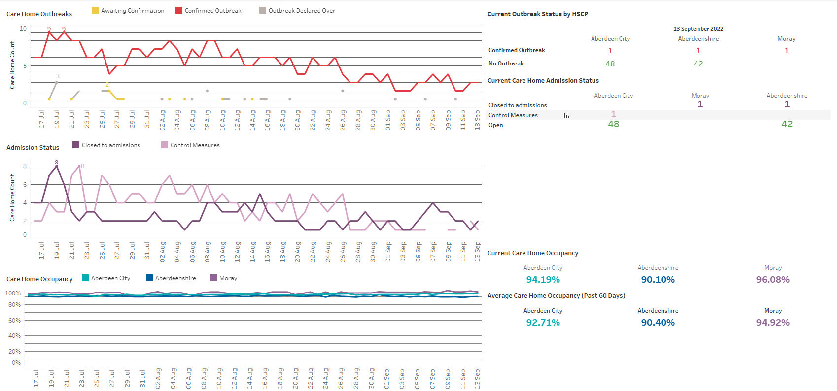
Care Home occupancy
Remains high; 2 homes closed to admissions
At 13 September:
Outbreaks down from July, 3 homes with confirmed outbreaks, one in each area.
Number of closed homes also remain low, only 2 homes closed and 1 with control measures in place.
Returns to TURAS have been falling, especially in Moray.
Occupancy below 60 day average in Shire, above 60 day average in City and Moray.
Care home data is from TURAS which is self reported and not assured centrally. Submission rates are not 100% and are lower at weekends.

Slide 16
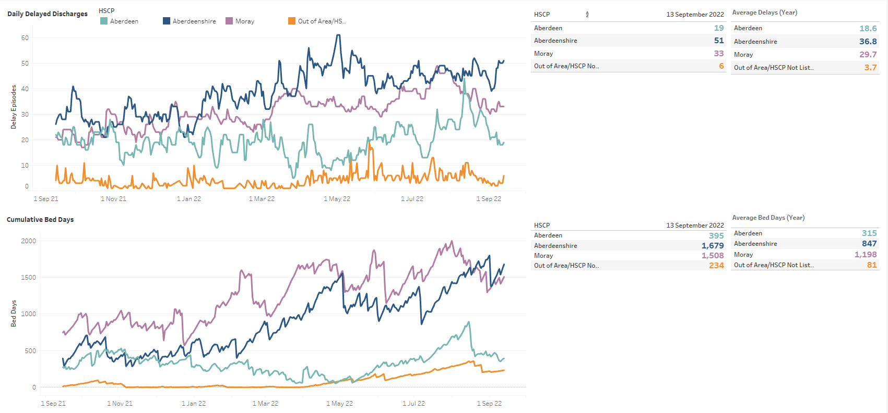
Delayed Discharges (standard delays only)
City delays continue general downward trend
At 13 September:
Shire delays still very high, a clear drop last week however have since risen again to late August levels.
City delays down again and Moray delay relatively stable this week.
Delays above average in all areas, however Moray and City close to yearly average. Shire delays 50% above yearly average.
Shire bed days lower than 2 weeks ago however trending upwards after a drop last week. Moray bed days have increased this week.
Shire bed days over 800 days above the yearly average. Moray 300 above yearly average and City delays closer to their yearly average.
End August fall in City bed days maintained again this week.
Out of area bed days have increased slightly this week.
Data shown for standard delays only as complex and Code 100 delays are typically harder for partnerships to control. Delays shown are daily snapshot delays from Trak which are not validated delays.

Slide 17
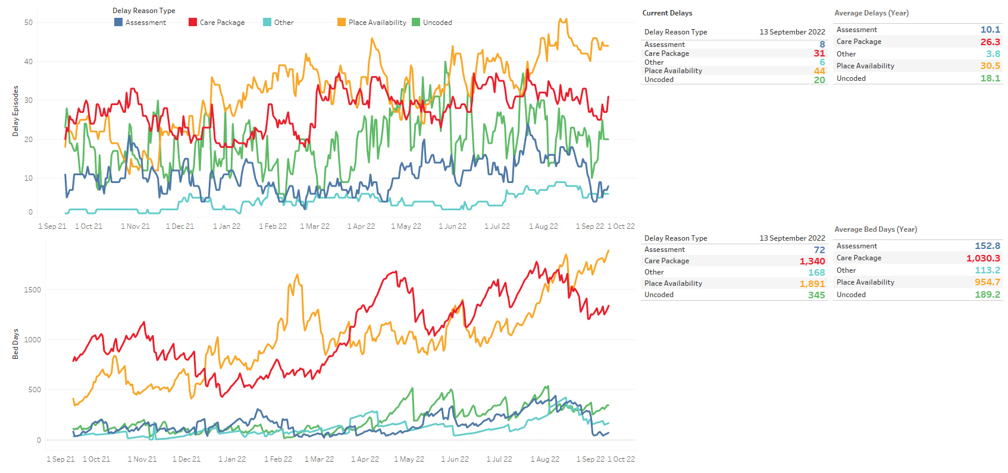
Delayed Discharges – Reason (NHSG standard delays only – out of area not included)
‘Place availability’ delays remain very high
At 13 September:
Jump in Care Package delays this week, now higher than yearly average but lower than August numbers.
Place availability delays very high, 1.5x yearly average. Sharp increase at the start of Sept maintained.
Assessment delays down from mid July and remain low.
Due to DD being snapshot at midnight, uncoded delays are over-represented as they are usually coded the following day, especially over the weekend/Monday.
Place availability bed days have now well over taken package bed days. Package bed days falling from July but stable for the past fortnight.
Shire have 1,068 place availability bed days, 56% of PA total. Moray at 470, 25% of PA total. City make up 353 bed days, 19% of the PA total.
964 Care Package bed days are in Moray, 72% of the total, 344 days are Shire, 26% of the total. City only have 32 – 2% of total..
Data shown for standard delays only as complex and Code 100 delays are typically harder for partnerships to control. Delays shown are daily snapshot delays from Trak which are not validated delays.

Slide 18
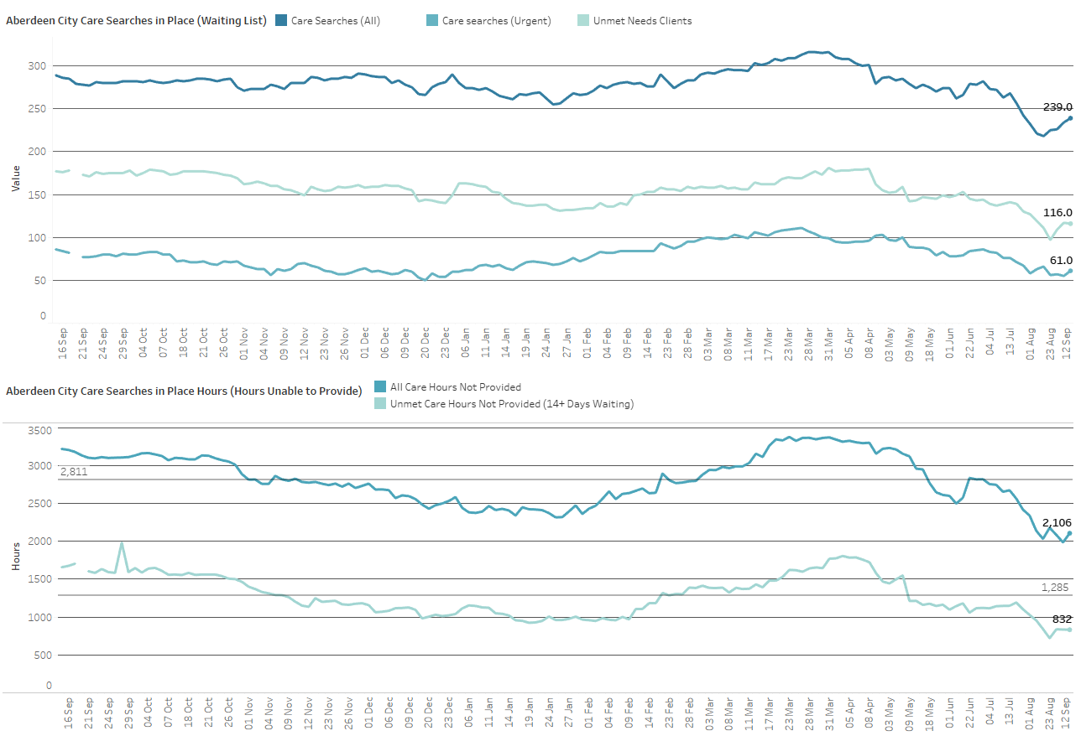
Aberdeen City Social Care
Hours not provided increased slightly but remain below annual average
At 12 September:
Care searches up 13 this week to 239, below yearly average of 279.
116 currently waiting over 14 days, up 7.
Urgent care searches at 61, up 4 on last week.
All hours now at 2106, up 22 and below the average of 2811 for the year.
832 not provided hours for clients waiting over 14 days, down 7 and below average of 1285 for the year.
For City, a care search is a record of a case where a care need has been identified but not fulfilled and how many hours of care are required (care search hours). These are weekly hours required per care search.

Slide 19
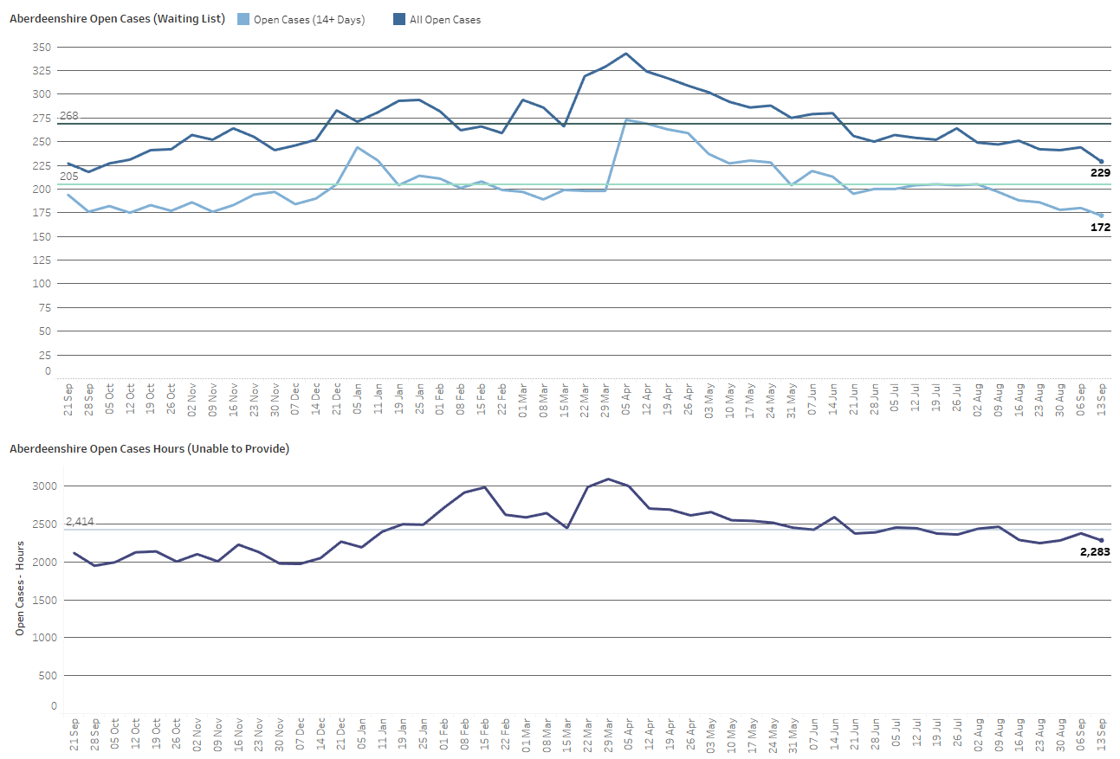
Aberdeenshire Social Care
Hours not provided have decreased slightly
At 13 September:
229 open case clients, down 15. Below the average for the year (268).
Open cases have fallen from April highs with unmet needs cases also reduced.
172 clients waiting over 14 days, down 8. Below average for the year (205).
Weekly not provided hours at 2283, down 92 this week and below yearly average (2404).
Open cases are where a care need has been identified and recorded on CareFirst. Open Cases hours are the weekly hours assessed as required for each open case. Homecare hours are hours which Shire are currently providing.

Slide 20
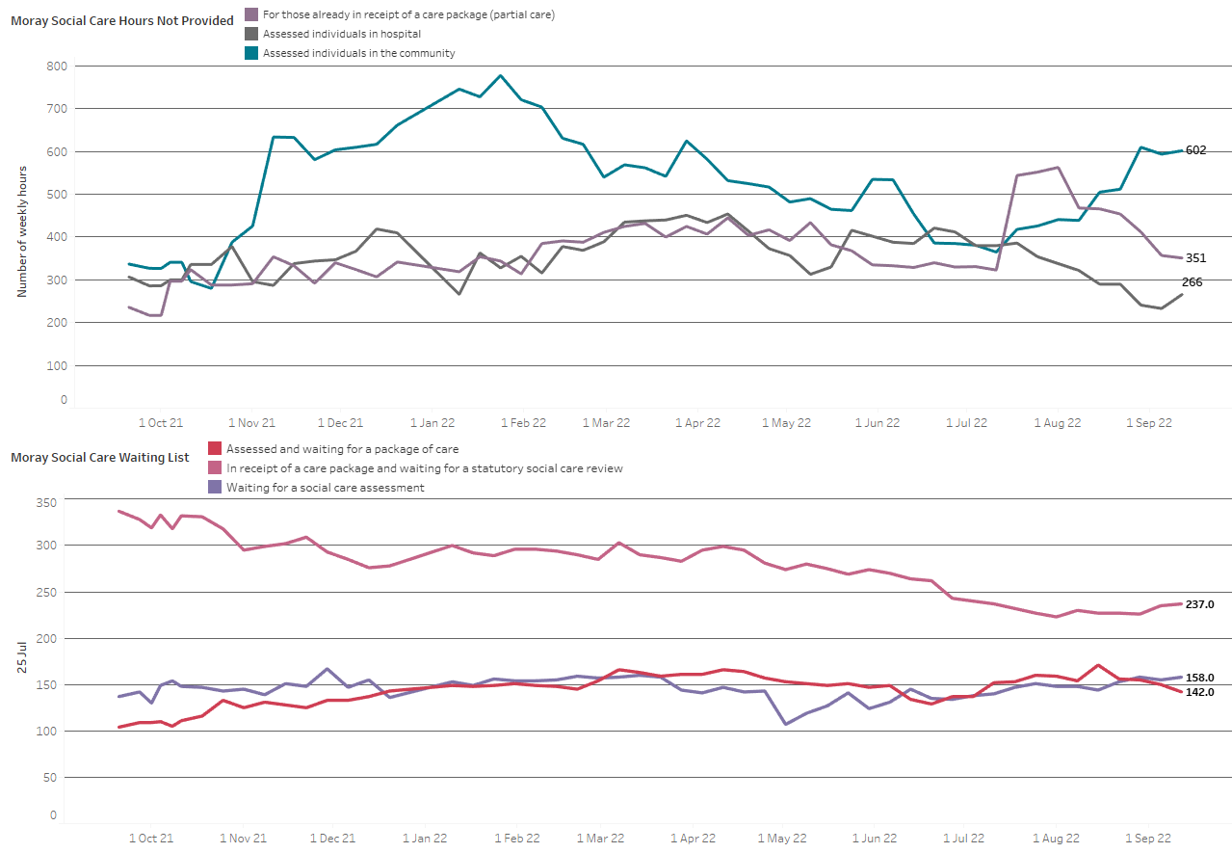
Moray Social Care
Hours not provided have increased slightly
At 12 September:
1,219 total hours not provided per week, up 35, below yearly average of 1,237.
602 care hours not provided in the community up 8 this week
266 hours for those in hospital, up 33 this week.
351 hours for those who already have partial care, down 6.
142 clients assessed, but waiting for care, down 8.
237 clients awaiting review, up 2.
158 clients waiting for a social care assessment, up 3.
Hours are the number of weekly hours identified as required for that individual. No data is available for length of time on the waiting list to identify unmet need.

Slide 21
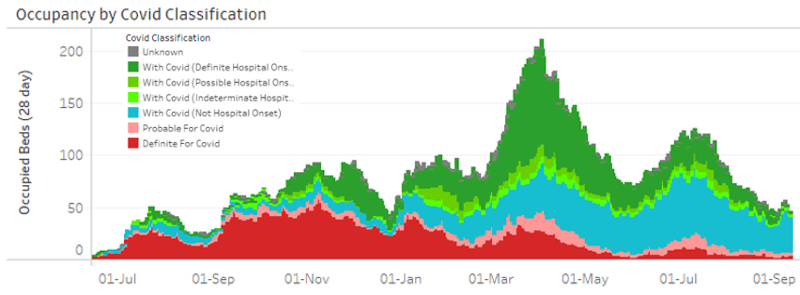
Covid summary
Admissions and occupancy increased through early September
Local case data has been falling since the end of June
  7-day rate to 28/08 was 49/100,000, which is down from 60/100,000 the previous week and 61/100,000 the week before
  As always, case numbers need to be interpreted cautiously due to far less testing being carried out in the community
The national ONS survey shows an uncertain trend in cases in Scotland; in the week to 28th August approximately 1 in 50 people in Scotland were estimated to have COVID over a 7-day period
  This compares to approximately 1 in 55 the week before. Cases had previously been dropping since mid-July
  NB
  there is a 15-25% under-ascertainment of Covid infection among hospital admissions since April 2022. This is due to home LFD tests not being logged and no test on admission
  With/For Covid admission classification should be used with caution. It is estimated that 10% of classifications may be impacted by ADASTRA data availability since 04/08
Hospital admissions have been rising during early September
  60 covid admissions in the 7 days to 13/09, a decrease from 63 the week prior, but an increase from the recent low of 36 in the 7 days to 30/08
  Data to 11/09 shows admissions have decreased in the over 70 age group but increased in all other age groups, notably the under 50 age group
  There were7admissions FOR covid (probable and definite) in the 7 days to 12/09, compared to 2 the previous week; the majority of admissions remain WITH covid (not hospital onset)
Hospital occupancy increased through early September from the recent low at the end of August
  At 13/09, 46 occupied beds (vs 49 a week previously)
  6 of these were admissions FOR covid (compared to 6 a week previously). Of those WITH covid, 3 are definite or possible hospital onset (compared to 3 a week previously) and 34 not hospital onset (compared to 36 a week previously)
  There is 1 patient in ICU

Slide 22
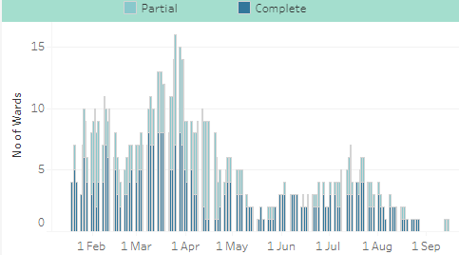
Infection Prevention & Control Ward Closures
1 partial ward closure
Ward closures due to Covid infection controls
As at 14/09, 1 partial ward closure due to Covid infection controls
Number of ward closures due to Covid infection controls was zero between 29 August and 12 September inclusive

