Slide 1
Fraserburgh Wellbeing CAD
Process Evaluation, Lessons Learned
& Agreeing Next steps

Slide 2
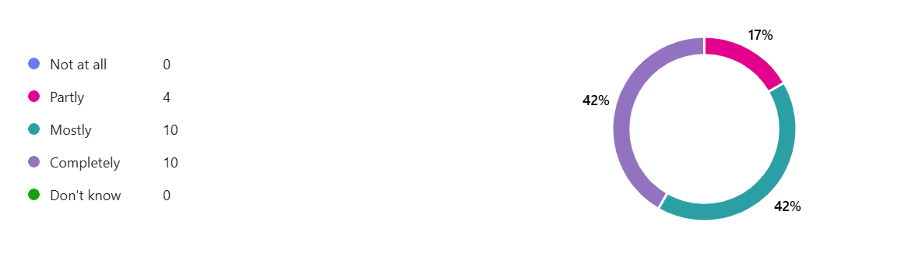
Ratings (complete)
“Please rate the experience you’ve had today” – 4.67/5 (n=27)
“How much effort was made to what was most important to you?” – 4.79/5 (n=24)
92% of attendees would recommend CADs to a friend of family member (“very likely” = 81%, n=26)
“Did today’s event address what matters most to you?” (n=24)
Completely
Mostly
Partly

Slide 3
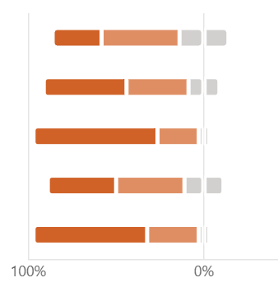
As a result of today’s event (complete)
My understanding of the key factors influencing good mental health and wellbeing is better than before – 76.2% (“much better” = 23.8%, “a bit better” = 52.4%, n = 21)
My knowledge of the tools that can help support my wellbeing is better than before – 85% (“much better” = 45%, “a bit better” = 40%, n = 20)
My knowledge about other services & support that can help me achieve good wellbeing is better than before – 95% (“much better” = 65%, “a bit better = 30%, n = 20)
My confidence in managing my wellbeing is better than before – 76.2% (“much better” = 33.3%, “a bit better” = 42.9%, n = 21)
My confidence in accessing services & support is better than before – 90% (“much better” = 55%, “a bit better” = 35%, n = 20)
“Much better”
“A bit better”
“Same as before”

Slide 4
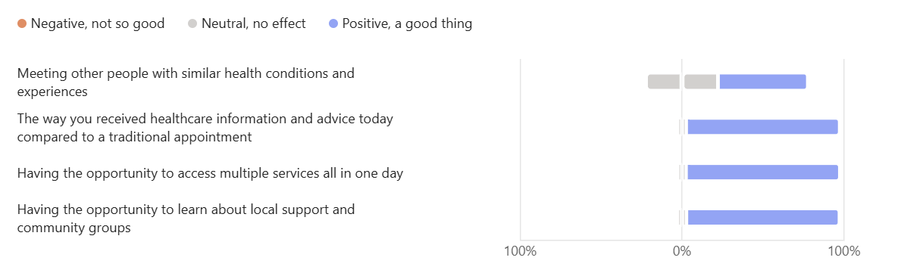
Can you tell us if you found any of the following at today’s event helpful?
Positive
Neutral
Negative

Slide 5
Comments
“…You have been friendly and kind - it's good to know there are people who care and want to help”
“Fantastic event, would encourage more of these to run regularly with a range of different services each time. “
“It would be great to see more of them! And in more towns.”
“This need to be a regular event to keep the community informed of what support is available.”
“Brilliant!”
“Very impressed by the wide range of services available. Everyone I spoke to was extremely friendly and helpful.”
“Really excellent variety, advice, lovely people. Thank you”

Slide 6
What stalls were visited?

Slide 7
What talks did people attend?

Slide 8
Demographics
73% of survey respondents who answered question were female (n=22)
Age range of respondents: 22 – 80 years old (median = 58, n = 22)
61% from Fraserburgh, 17% from surrounding villages and 22% from Peterhead (n = 22)
Deprivation: All 5 SIMD quintiles represented (n=18)
- Most deprived - 17%
SIMD 2 – 17%
SIMD 3 – 22%
SIMD 4 – 22%
Least deprived – 22%

Slide 9
Transport
Only 3 respondents (18%) were aware that THinC could organise transport (n = 17)
77% used own transport while 23% walked (n = 22)
No respondents used public transport

Slide 10
Story
A stallholder described how a person attending an event initially shared suicidal thoughts with a mental health charity but did not want an appointment at that time. The person then approached an advice service to ask about their state pension. During the conversation, the stallholder took a holistic approach, discussing wider issues affecting their wellbeing. The person shared that they were unhappy, experiencing suicidal thoughts, and struggling with housing costs, particularly heating a home that felt too large and expensive to maintain.
The stallholder signposted them to an energy advice service for support with insulation and offered a follow‑up appointment regarding pension advice. The person commented that future support felt pointless as they did not expect to be around for long, indicating that their suicidal thoughts were serious.
The stallholder continued to engage and worked with the mental health charity to arrange a private space to talk. While the person was initially reluctant, they later agreed to speak with the mental health team after being supported by other services on site. When seen again, the person appeared more positive.
The stallholder reflected that the person was able to open up more because the interaction was not solely focused on mental health. By understanding recent bereavements and wider life pressures, the team was able to connect them with appropriate support. The stallholder felt that having multiple services working together in one place enabled timely, joined‑up support that may have prevented serious harm.

Slide 11
Wider learning
Earlier identification of planning leads and allocation of roles, would help to reduce the time required to plan future Community Appointment Days.
It is noted that Fraserburgh now has a CAD ‘blueprint’ which will make it easier to plan future CADs.
With teams facing ongoing capacity constraints and multiple competing priorities, CADs must be developed in a way that integrates with existing work and progresses at a pace that is sustainable for local partners.
Some logistical issues were raised, such as limitations in parking, which could potentially be avoided for future events.
Clearer and wider communications for the event to increase attendance.
Effective engagement with a broader range of partners including with General Practice, could help to increase number of attendees at future events.
The topic of ‘wellbeing’ was perhaps too abstract and future events need to consider a clearer ‘hook’ to help engage people in attending future CADs (albeit wellbeing remains a core focus of all CADs).

Slide 12
Wider CAD plans to support Fraserburgh
CVD CAD Stonehaven – GP led
Orthopaedics potential CAD – secondary care working with primary care and communities
Supporting local CADs – supporting local ‘ground up’ developments: CAD Companion

Slide 13
Questions
General comments reflections?
Has the CAD sparked new thinking/ways of working for you and your team locally?
Thoughts on next steps based on CAD developments which are in progress?
Propose to stay connected as we learn from other CADs – June update?

